Slide 1
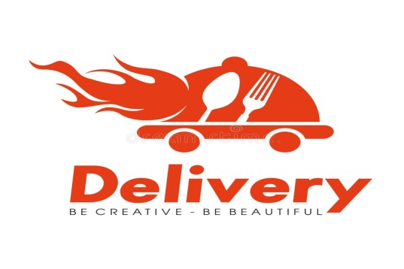
Foodies Online Food Delivery System Group-6

Slide 2

Team Members
Employee Id | Name
2528115 | Rahul Goyal (Team Lead)
2527983 | Ramanarayani M
2528743 | Sai Siva Kumar S
2527913 | Sakthivel V
2528262 | Saksham Tiwari
2527438 | Saman Shrestha
2526794 | Sandhya Mathi R
2530078 | Saranya Ravichandran
2529199 | Sarath P

Slide 3

Content
Introduction
Scope
Introduction
Objective
PHASES OF PROJECT DEVELOPMENT
Technologies Used
Homepage Modules
Admin actions and user actions
Integration

Slide 4

INTRODUCTION:-
The e-commerce market has experienced strong growth over the past decade, as customers increasingly move online.
Online Food Ordering is the process of ordering food, for delivery or pickup, from a website or other application. The product can be either ready-to-eat food (e.g., direct from a home-kitchen, restaurant, or a virtual resturant) or food that has not been specially prepared for direct consumption (e.g., vegetables direct from a farm/garden, fruits, frozen meats. etc).
Online ordering has started to become the norm, thanks to the convenience, accuracy, and ability to integrate payments. At scale, ubiquitous on-demand and subscription delivery of prepared food could potentially spell the end of cooking at home

Slide 5

Objective
An online food ordering system is a place where customers can directly order the food from the restaurant instead of Going out to get the food.
The main objective of the Online Food Delivery System is to manage the details of Item category, Food, Order, Add the items to cart
To provide a bug free online food delivery system to users as well as admin.

Slide 6
Phases of Project:
Phase 1: Database Schema Design
1.See The domain objects and their attributes as per the requirement.
2.Create a Database tables with necessary relationship as per the requirement.
Phase 2: Front End Development
Develop a static web page as per requirements for online food delivery web application using Angular.
Phase 3: Back End Development
Create DAO class for performing Crud operation using Spring Data jpa for each Entity.
Phase 4:Unit Testing
1.Perform Unit Testing using Junit frameworks for all the functional requirements.

Slide 7



Technologies Used
Front-End: Angular Angular is a Javascript framework that is used by developers for building web, desktop, and mobile applications. Development of Angular applications involves usage of Typescript, which is a superset of Javascript, along with HTML, CSS etc
Spring boot:-Spring Boot is an open source Java-based framework used to create a micro Service. It is developed by Pivotal Team and is used to build stand-alone and production ready spring applications.
Hibernate is a Java framework that simplifies the development of Java application to interact with the database.
MySQL : MySQL is currently the most popular database management system software used for managing the relational database.
Apache Tomcat :Apache Tomcat allows the implementation of Java Servlets and JavaServer Pages (JSP) to promote an effective Java server environment.

Slide 8
Portal
Admin Portal
User Portal

Slide 9
Flowchart For Admin
START
LOGIN
IF CREDENTIALS ARE CORRECT
FALSE
TRUE
ADD DETAILS
UPDATE DETAILS
DELETE DETAILS
STOP

Slide 10

Flowchart User
START
REGISTRATION
FALSE
IF CREDENTIALS ARE CORRECT
FALSE
LOGIN FALSE
IF CREDENTIALS ARE CORRECT
VIEW DISHES
ADD TO CART
BUY NOW AND PAYMENT
ORDER SUMMARY
LOG OUT

Slide 11
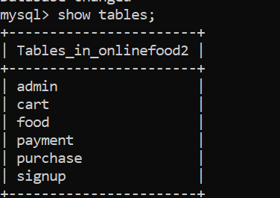
Database Architecture
Entities in the Database:
admin
cart
food
payment
purchase
signup

Slide 12
LIST OF MODULES:
User Registration
User Sign-in
User Dashboard
User Add to Cart
User Payment Process
Admin Sign-in
Admin-Dash Board
Admin Log Out

Slide 13
Functional Requirements
Admin Functionalities:
1.Login to portal
2.Add or remove cuisines to or from the application to build a rich product line
3.Edit food item details like name, price, cuisine and description.
4.Delete food items

Slide 14

User Functionalities
1.Register to the application
2.Sign into the application to maintain the record of activities
3.Search for food items based on the search keyword
4.Apply filters and sort results based on different cuisines
5.Add all the selected food items to a cart and customize the purchase at the end
6.Perform a payment process
7.Summary of the order

Slide 15
MODULE DESCRIPTION
User Registration Module
The User Registration lets User to register their details .
The admin will maintain the registered details for further purposes.
The user will enter details like Username, Email, Password, Address, Phone number.
After entering these details, the User can register their new account.
After successful registration, will receive a popup stating “Successfully Registered”.

Slide 16

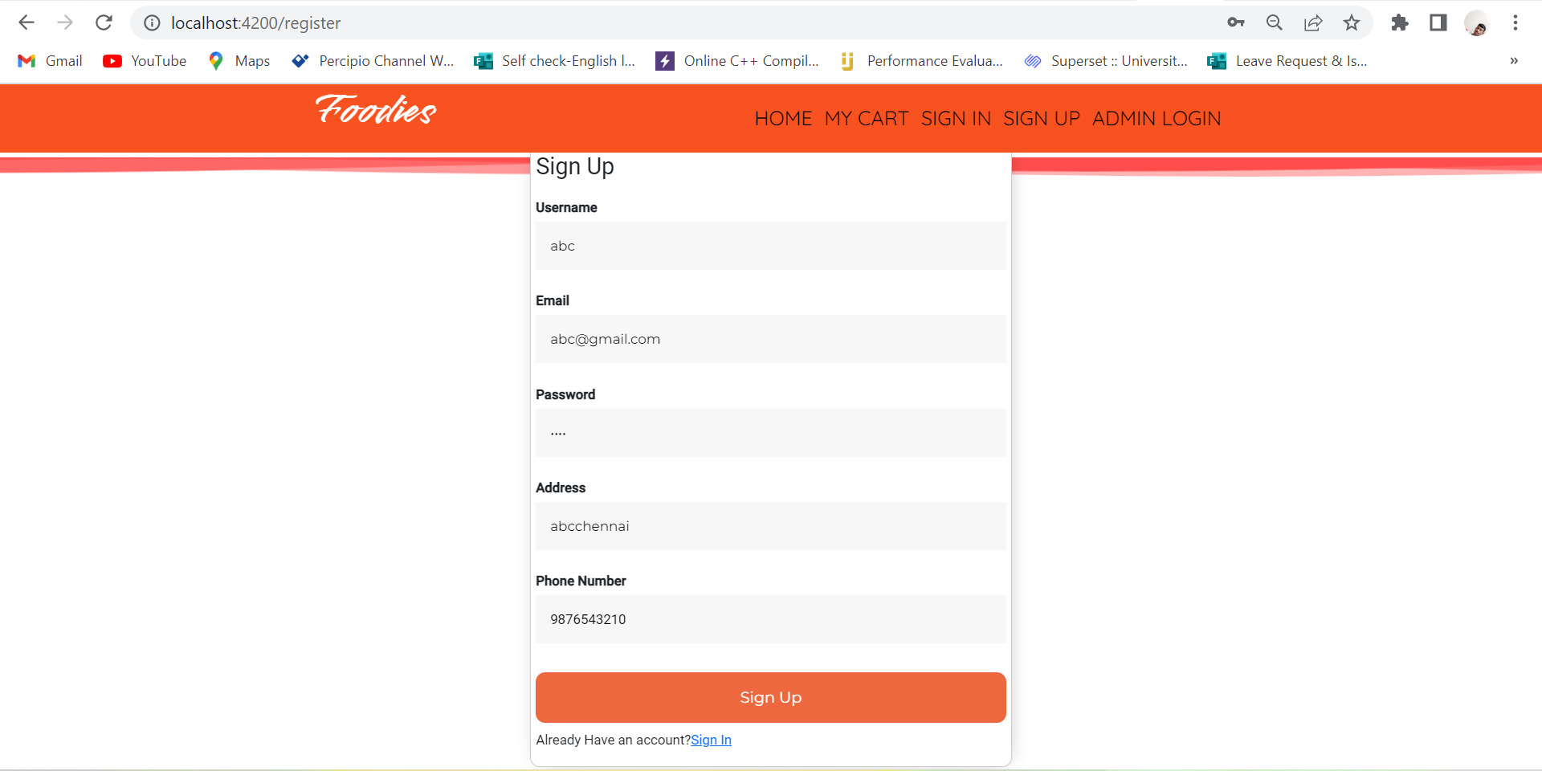
User Screenshots

Slide 17
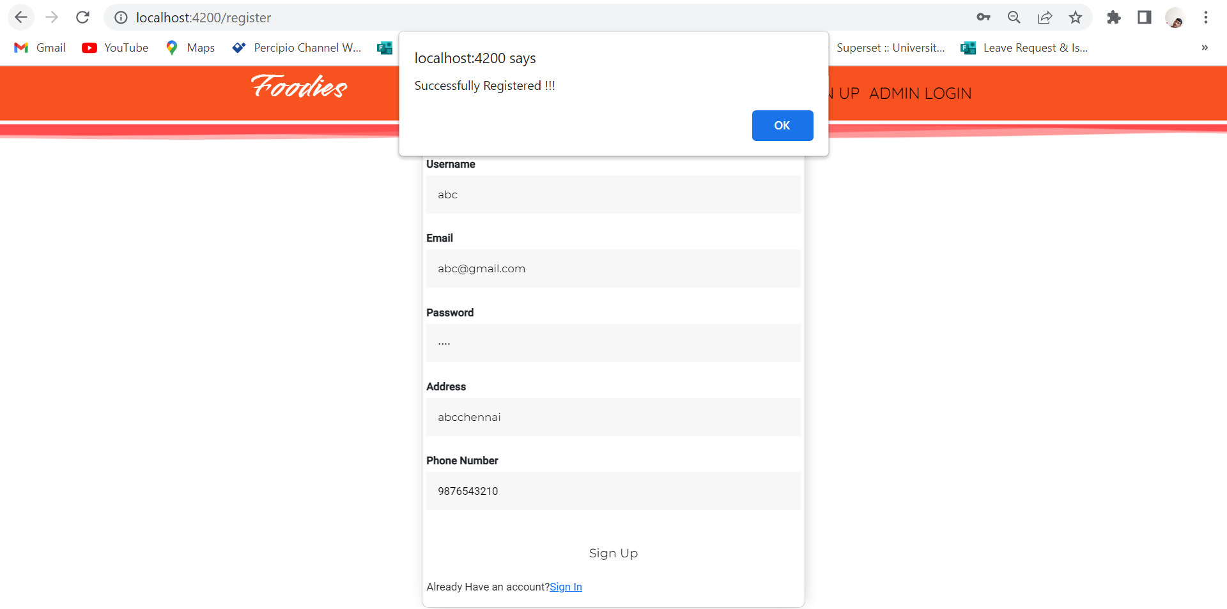

Slide 18
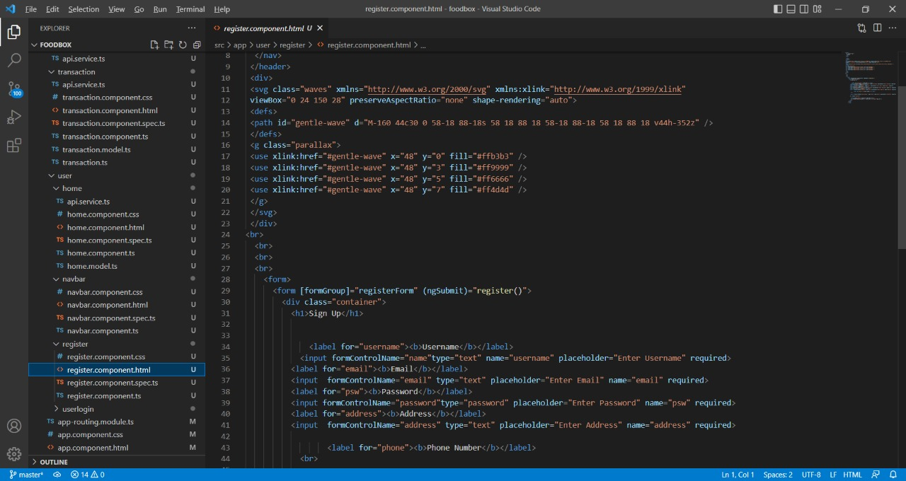
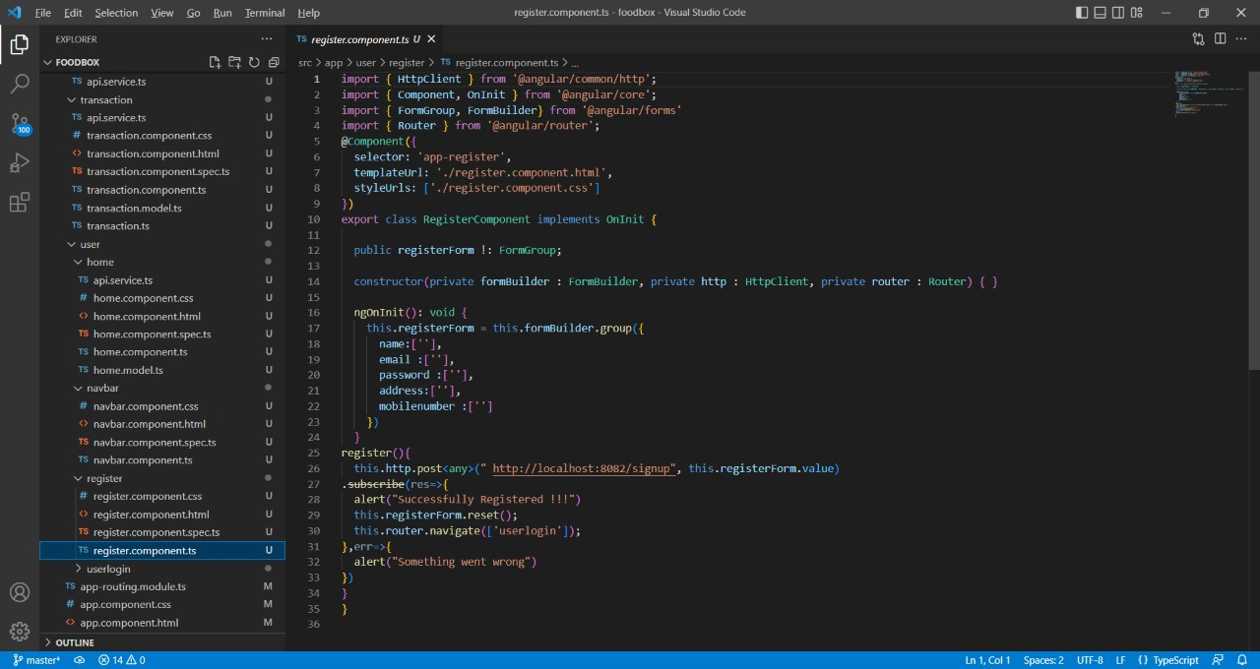

Slide 19

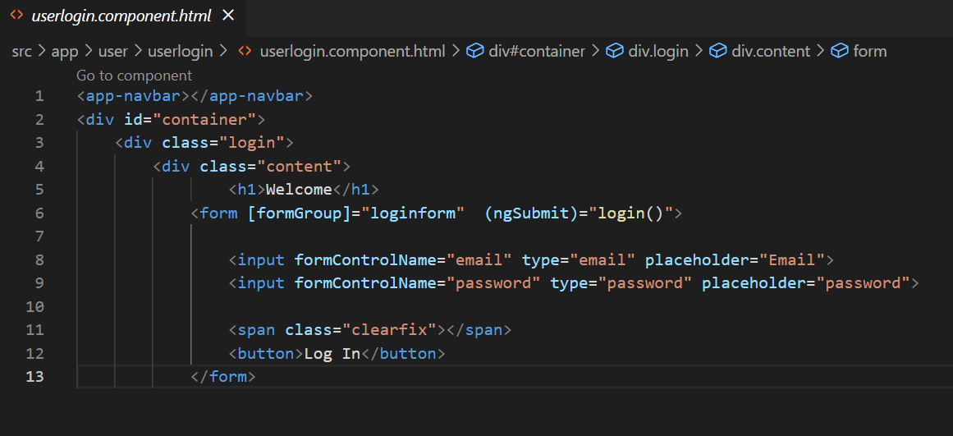
User Login
The login module enables the User to login to their portal.
The user need to enter the valid Username and Password to login page.
If the user login credentials are correct ,it will redirect to the user Dashboard.

Slide 20

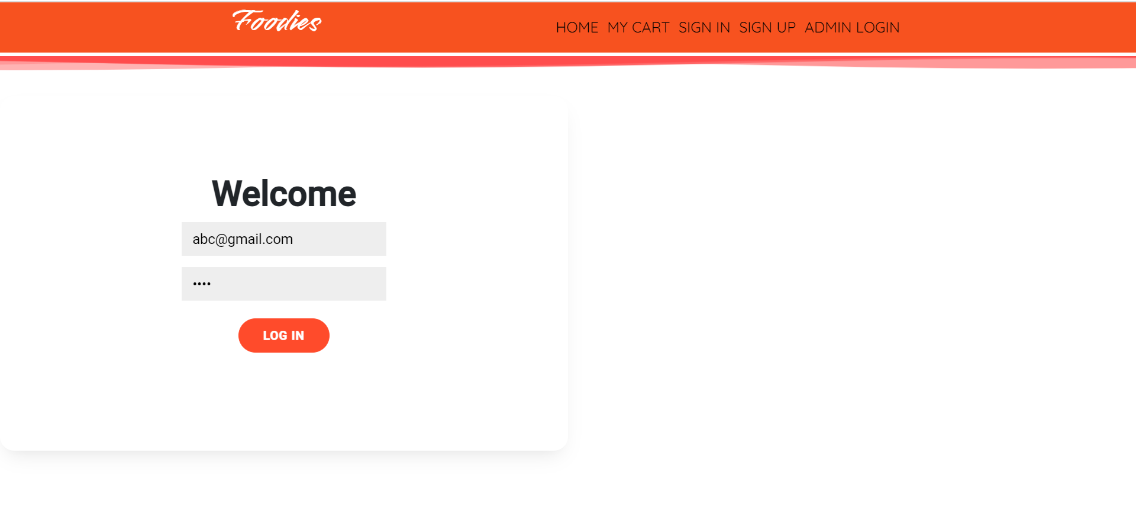
User Login Screenshots

Slide 21
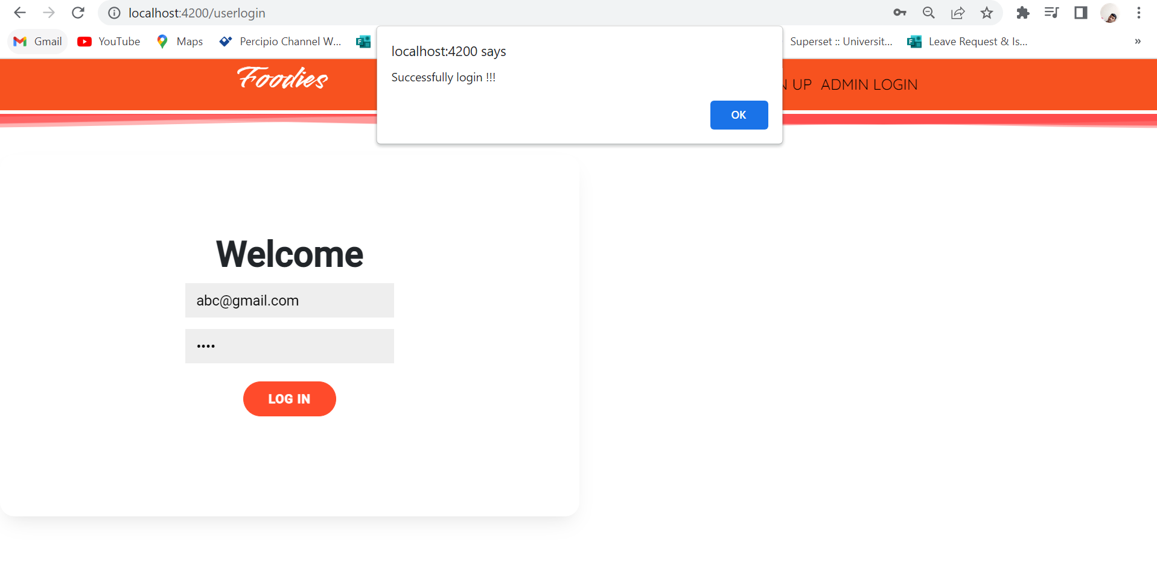

Slide 22
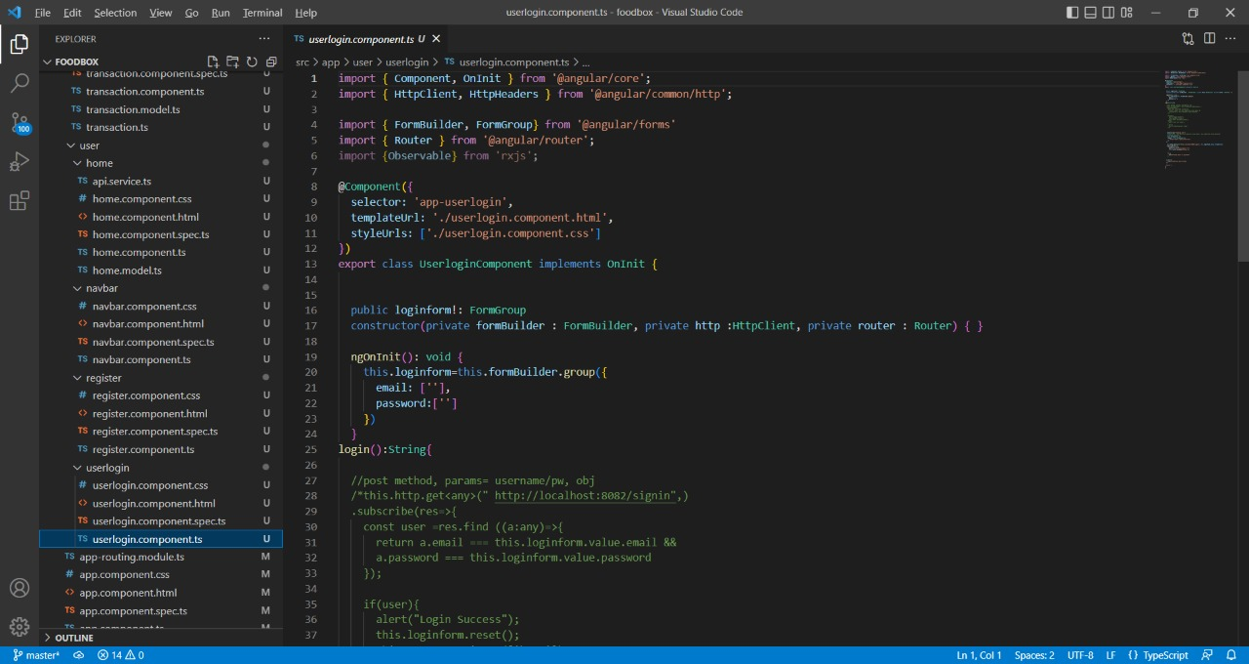

Slide 23
User Dashboard
After successful login, the user directs to User dashboard.
Here the user see the food name , category , Cusine Type, Description of food
Offers going on products ,Price of Food
And Can Add Foods to Cart
User Can Navigate to My Cart
User Can Sign up again
User Can Go to Home Page From Cart

Slide 24

User Dashboard Screenshots

Slide 25
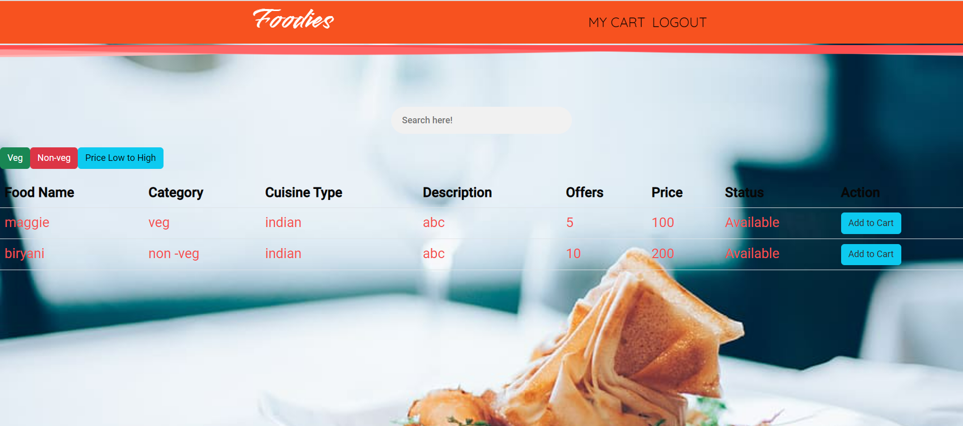

Slide 26
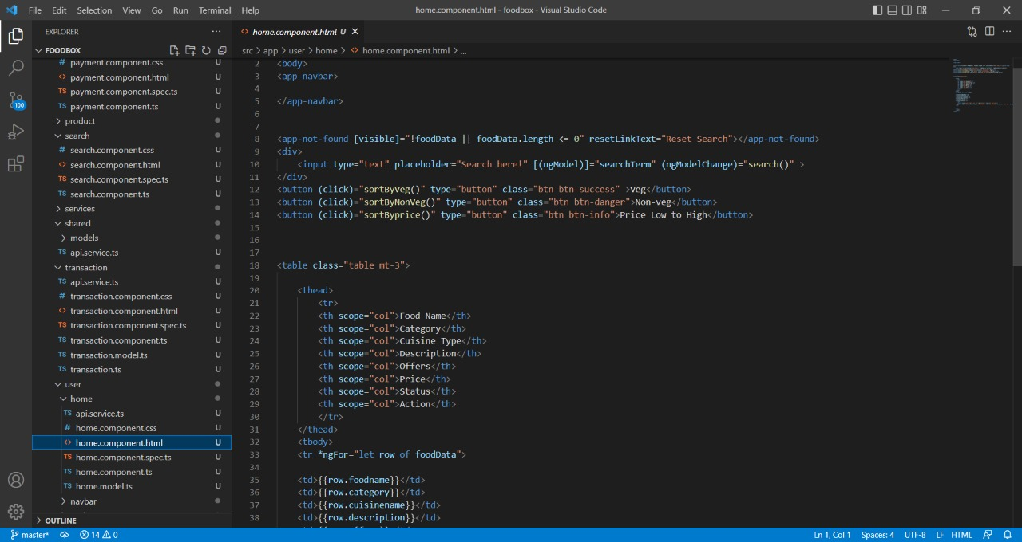
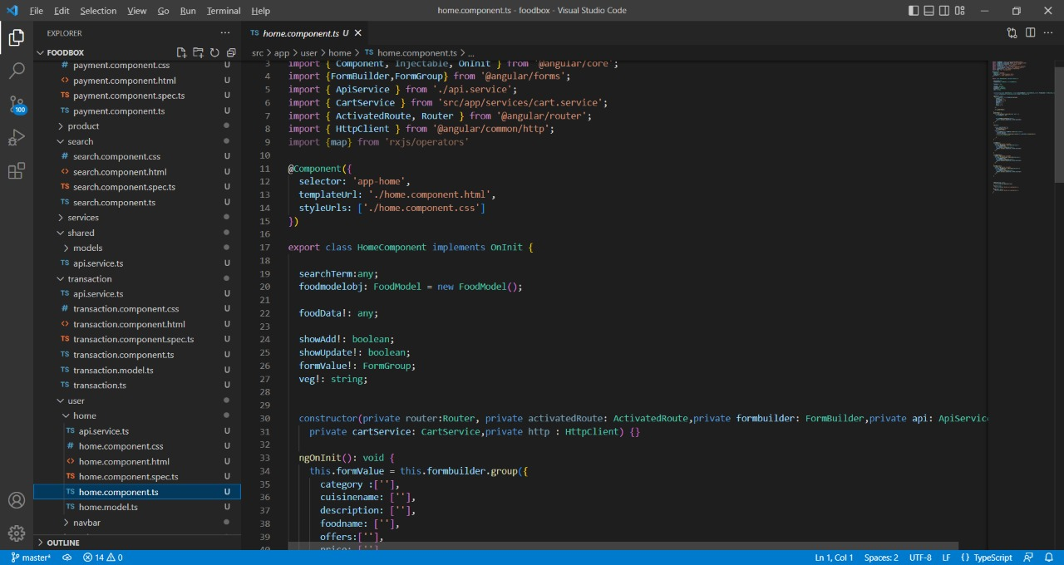

Slide 27
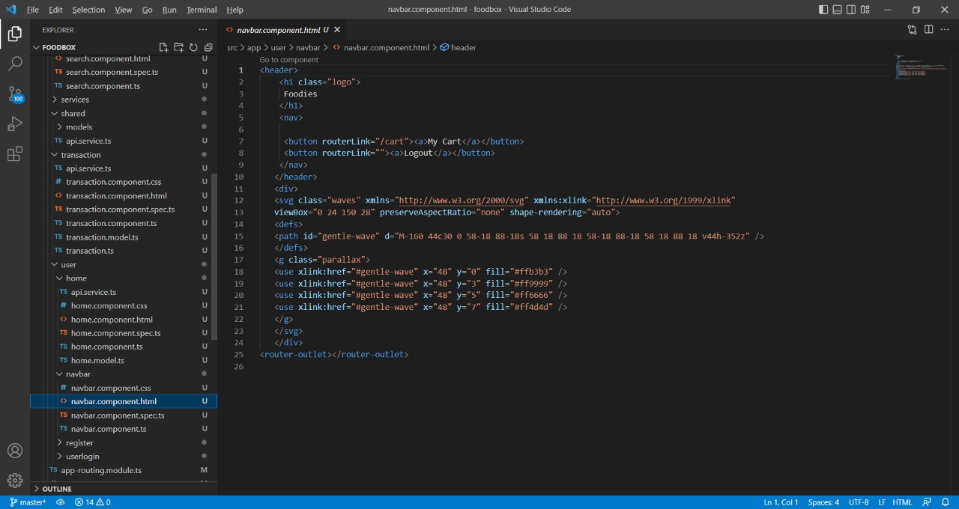

Slide 28
Cart Module
The customer can add the food items into the cart by clicking add to cart button .
The customer can add more than one item in the cart page and can change the quantity of items that user has selected.
The total amount of food items that user has selected will be shown an user can do the payment by clicking proceed to payment button.

Slide 29
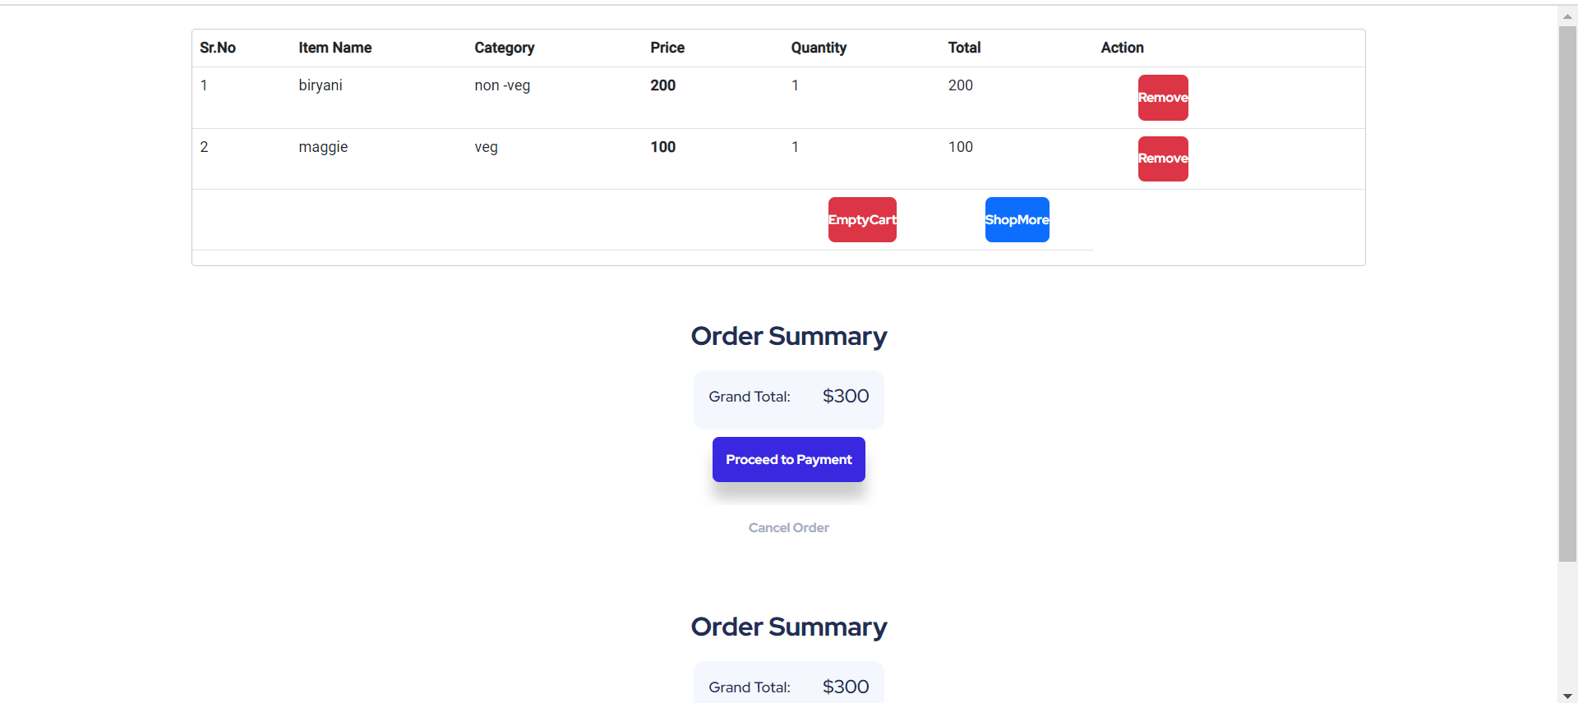
Cart Module Screenshots

Slide 30
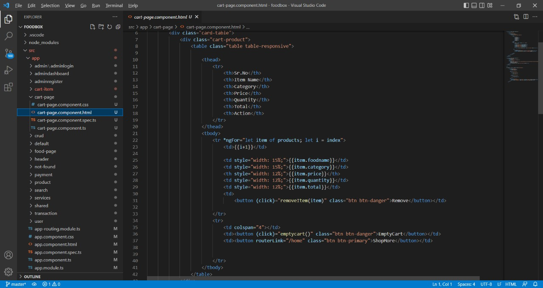
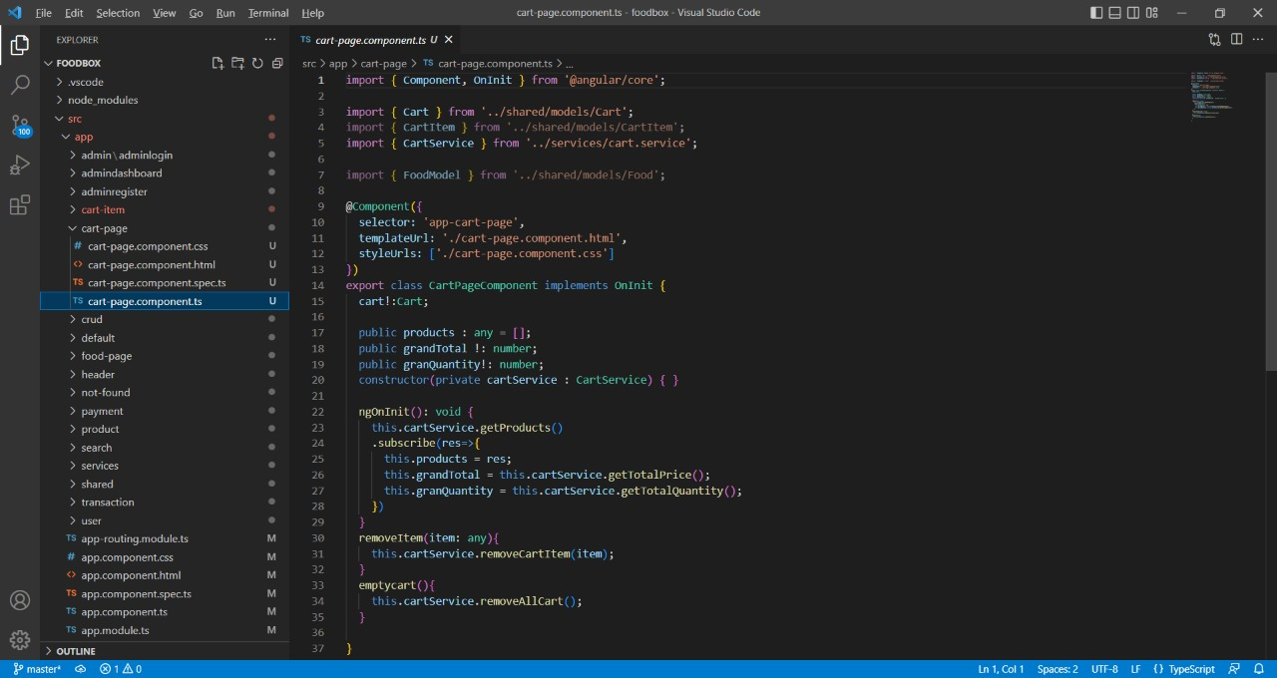

Slide 31
Payment Module
User needs to proceed to payment by inserting card details.
Including there card number ,CVV, Expiry date.
The order will be confirmed.

Slide 32
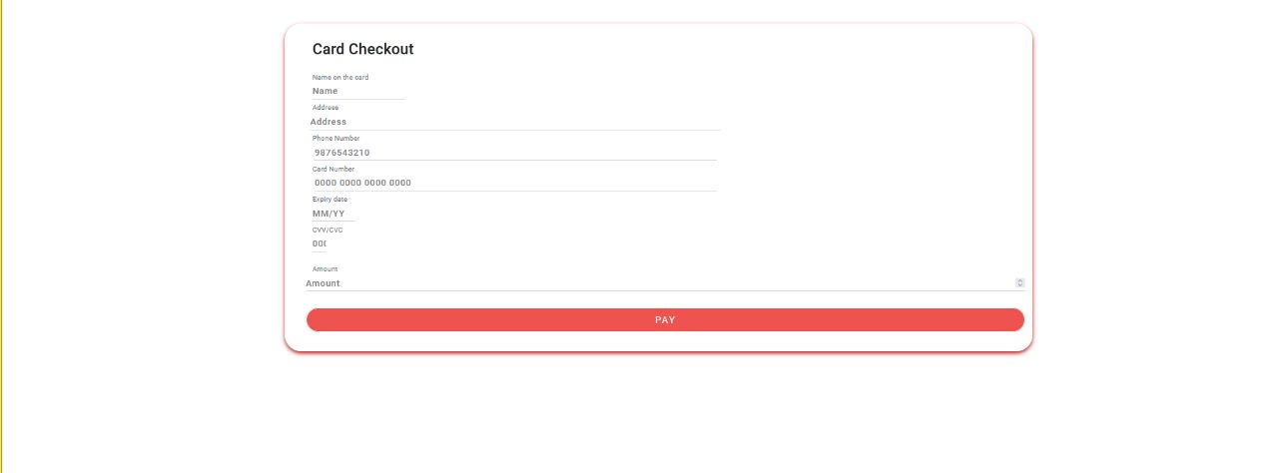
Payment Screenshots

Slide 33
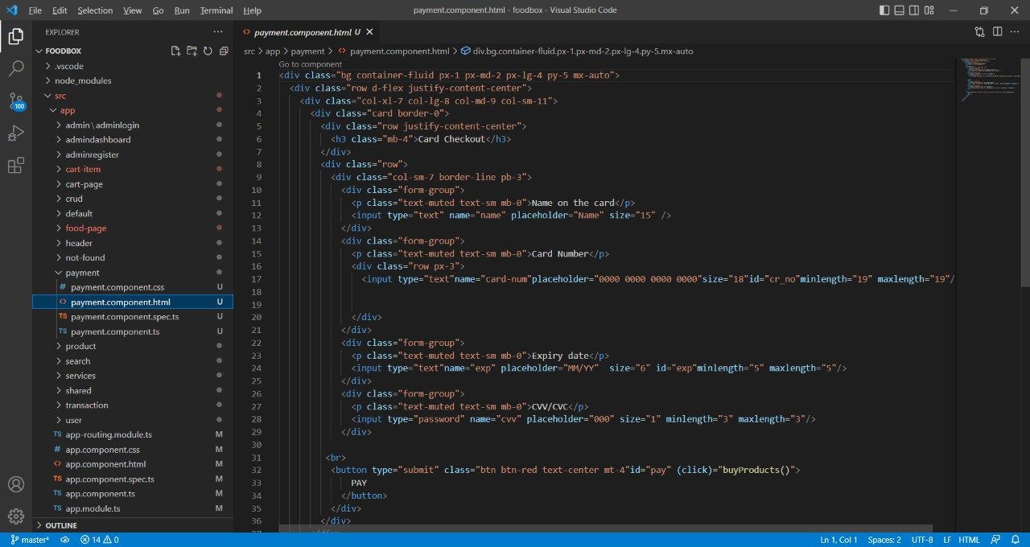
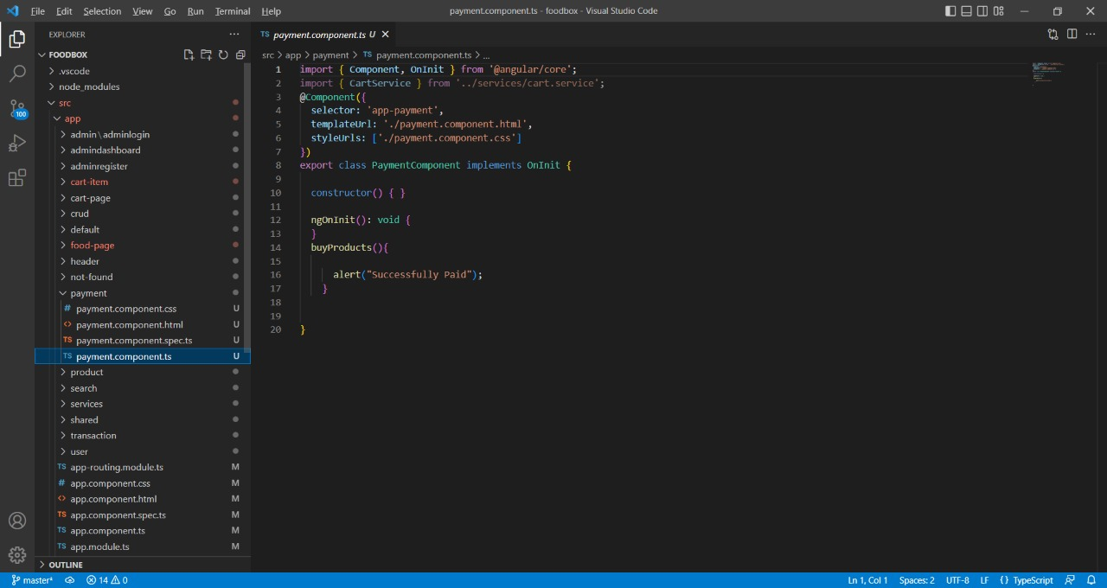

Slide 34

Admin Login
To view all the users and to do all actions admin must complete the login process.
Once the admin complete the login successfully it redirects to the admin dashboard page
If the credentials are wrong it will show the error popup message as Login failed.

Slide 35
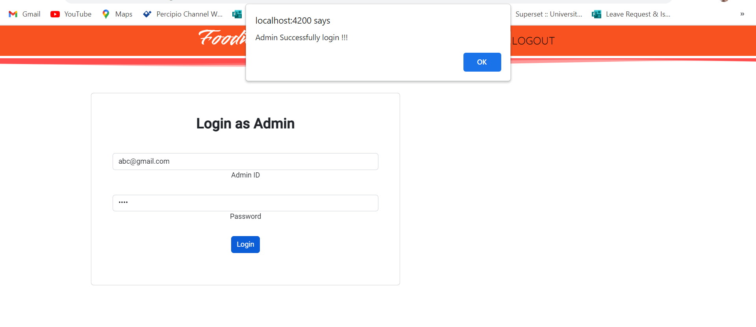
Admin Login Screenshots

Slide 36
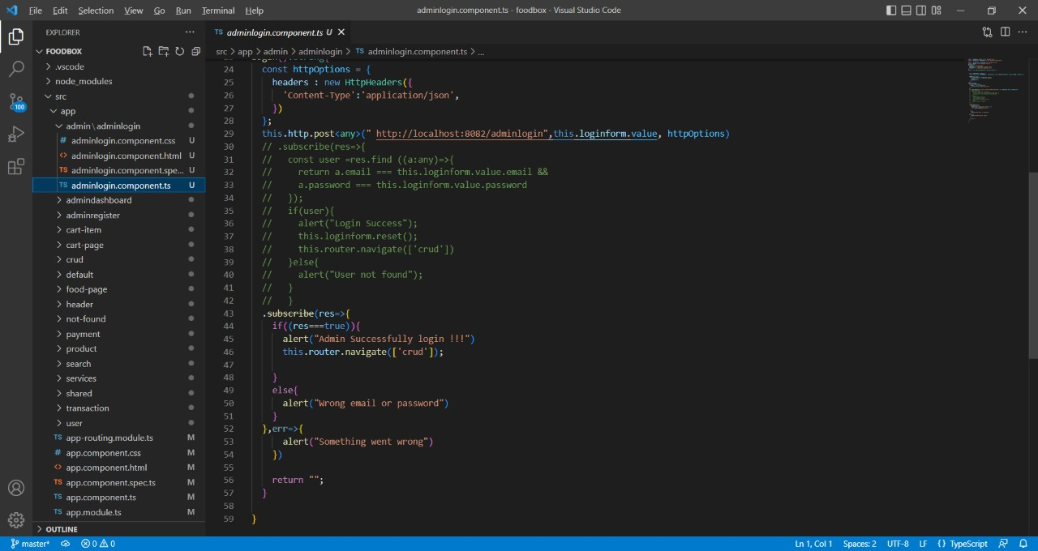
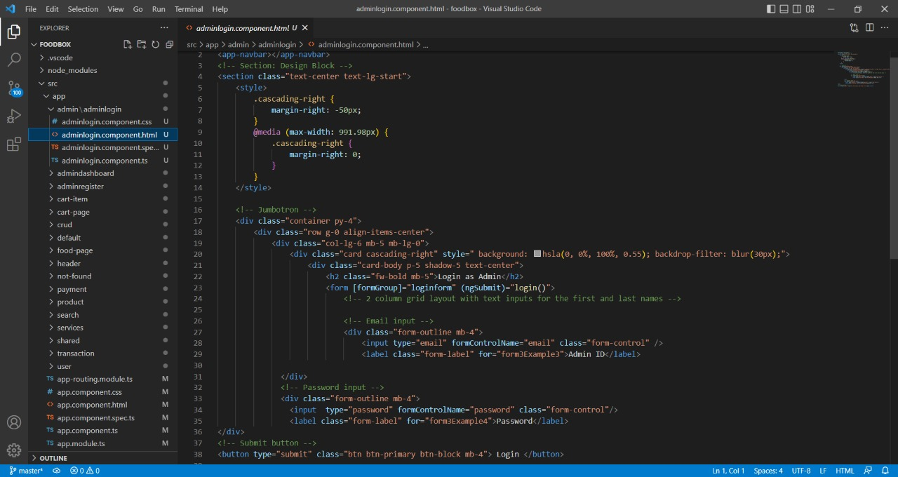

Slide 37


Admin Dashboard
The Admin Dashboard is handled by admin for adding, deleting and editing the Food Details.
If the Admin causes any changes to the Adding the details in the dashboard, it reflects on the User Side also.
Adding new Food details will ask some details like Food name, Category , Cuisine Type, Offers, Price, Status.

Slide 38
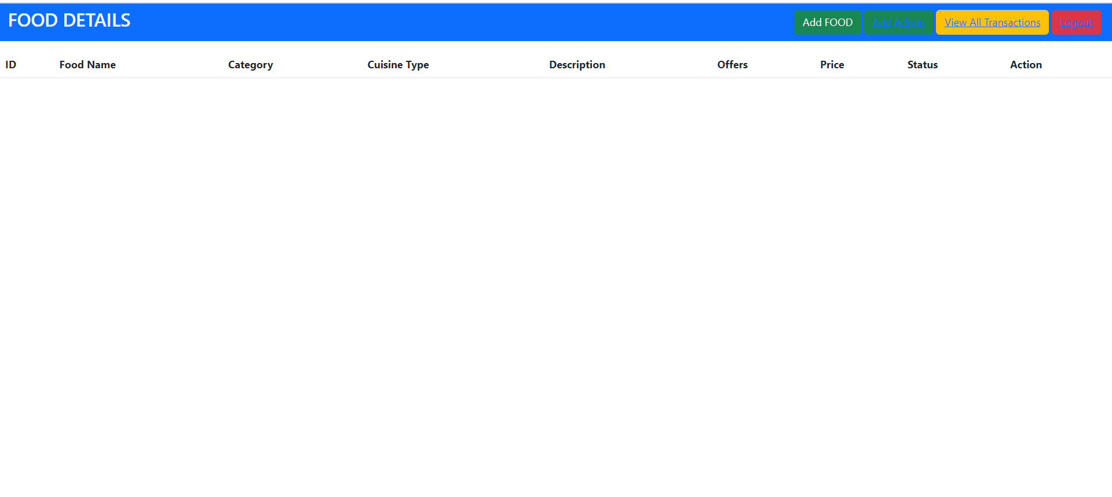
Admin Dashboard Screenshot

Slide 39
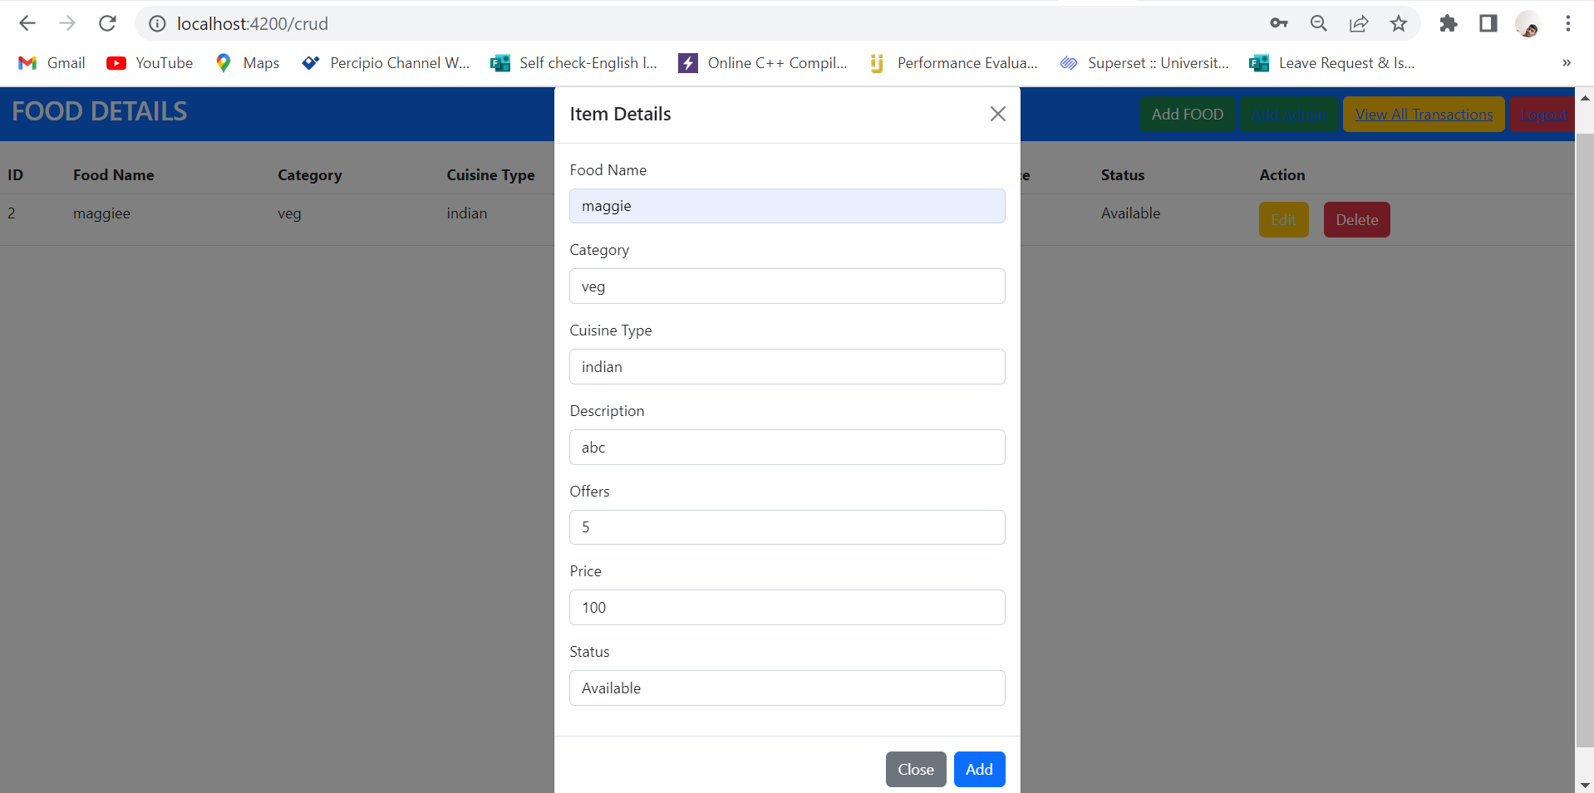

Slide 40
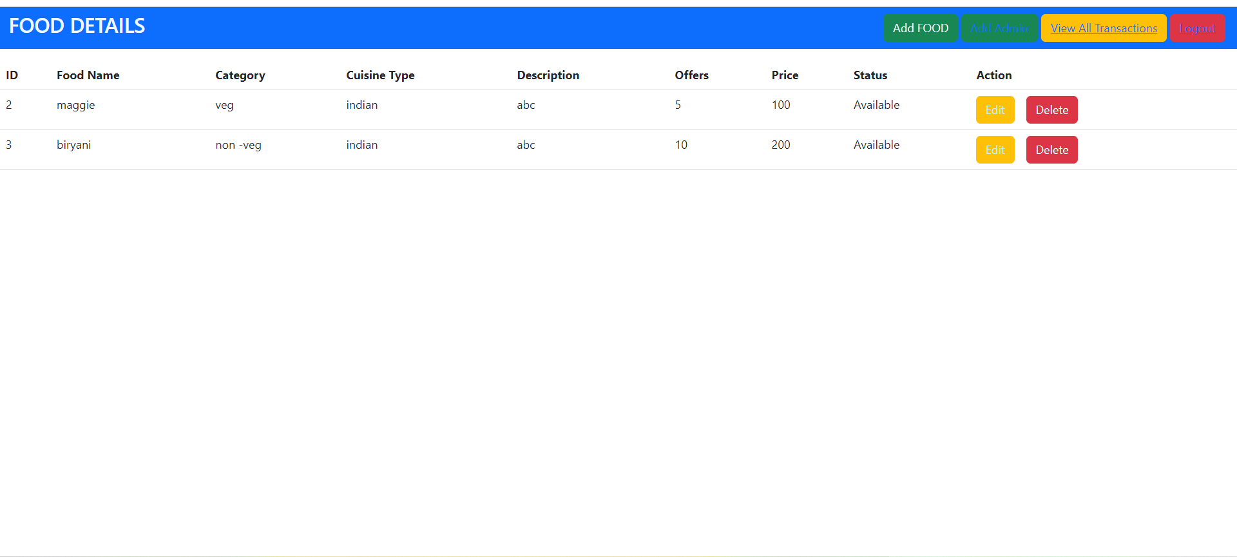

Slide 41
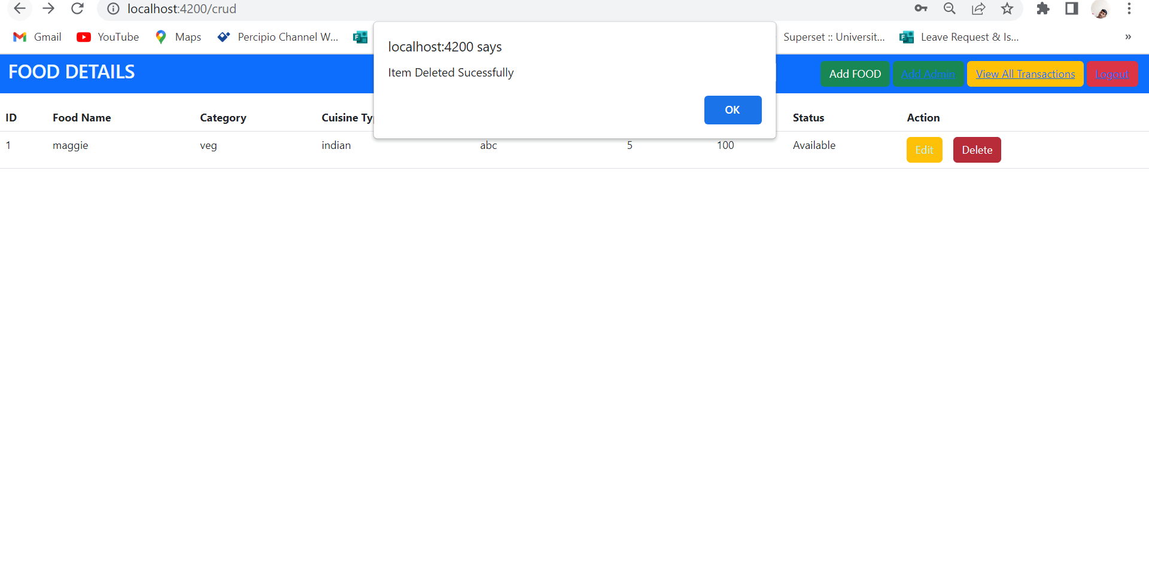

Slide 42
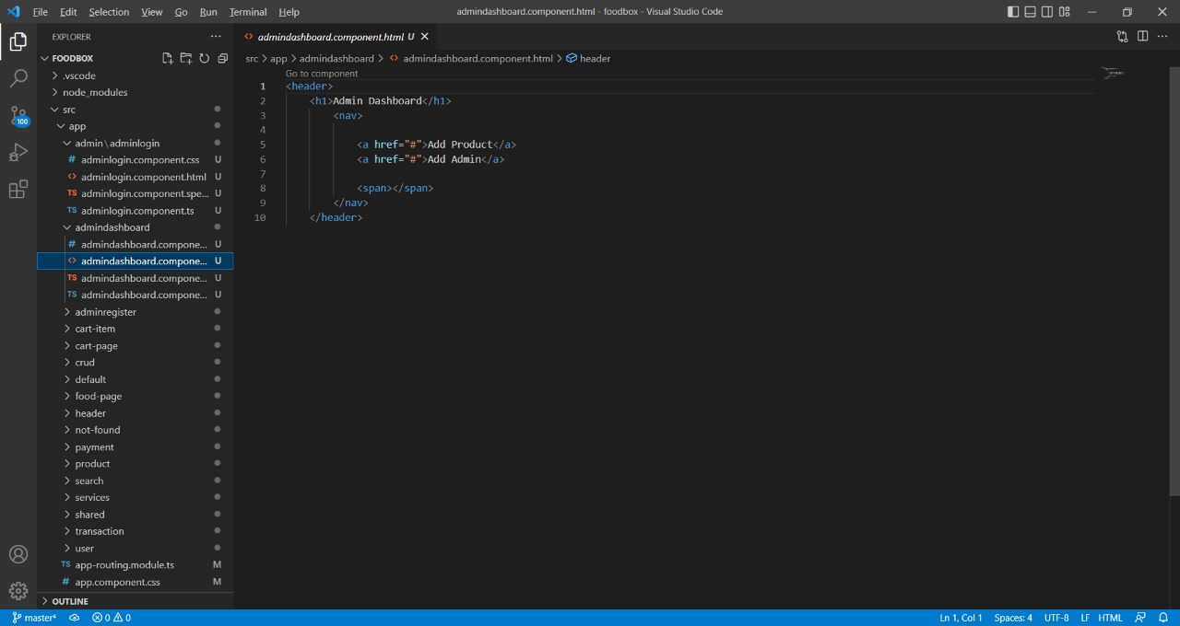
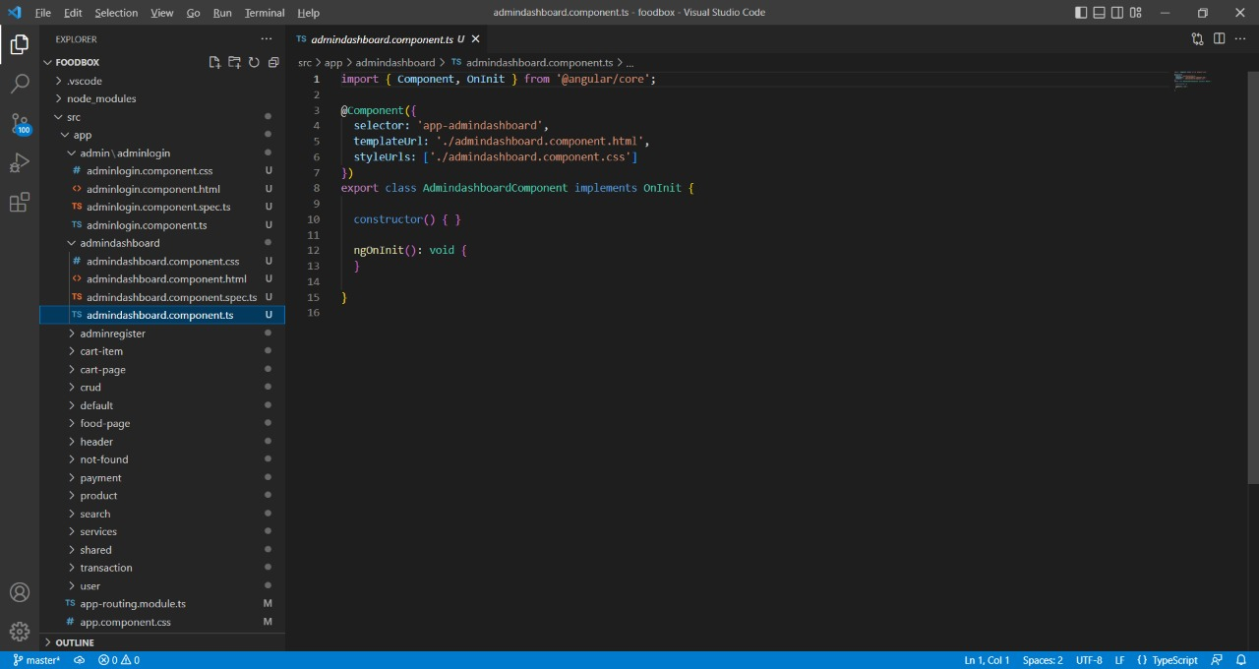

Slide 43
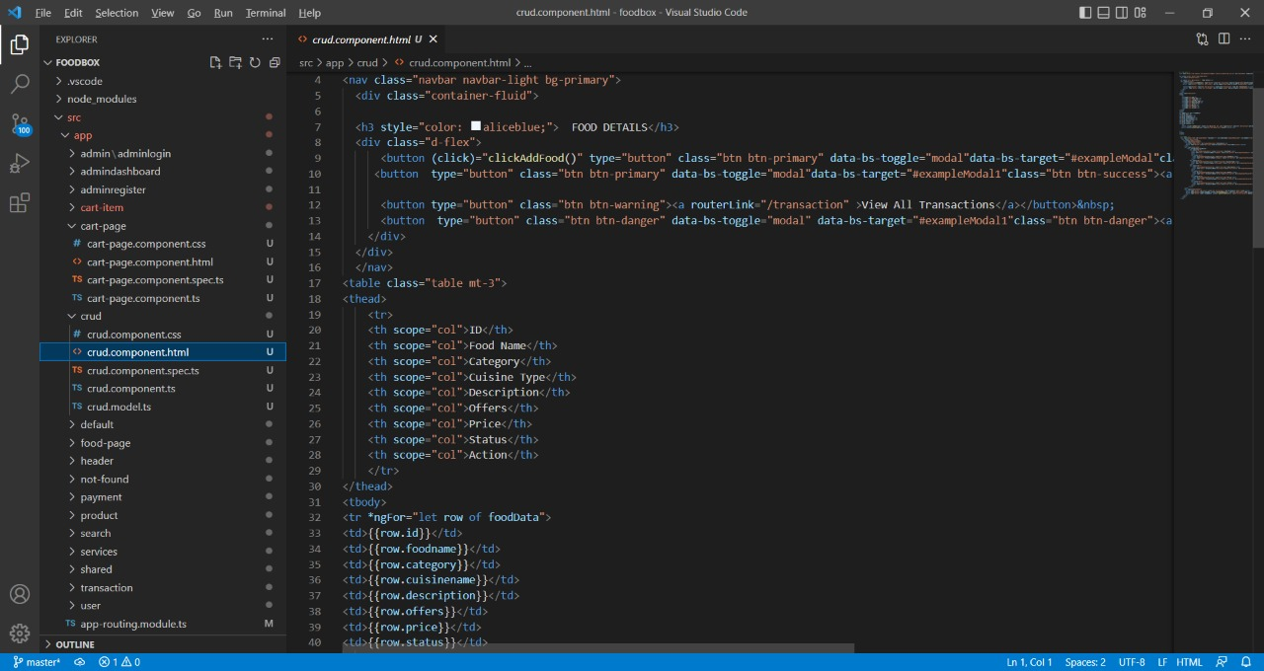
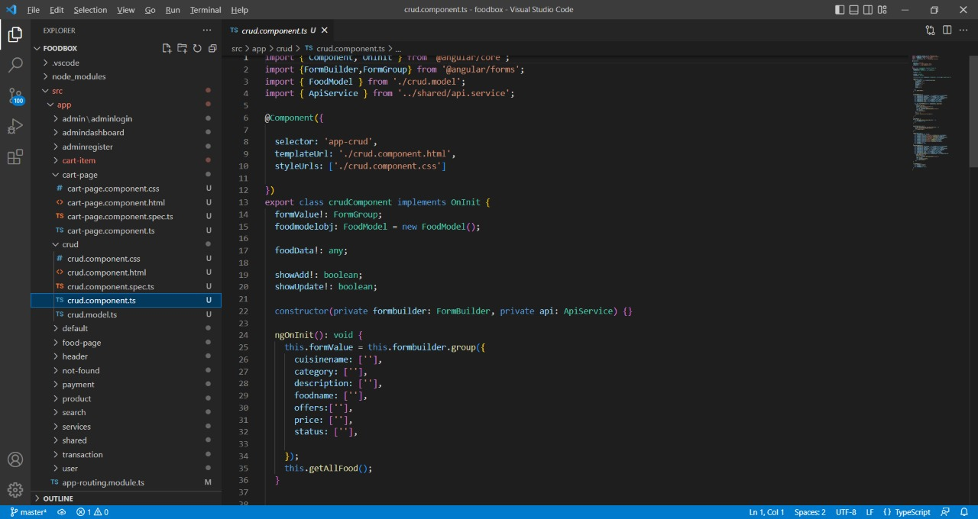

Slide 44

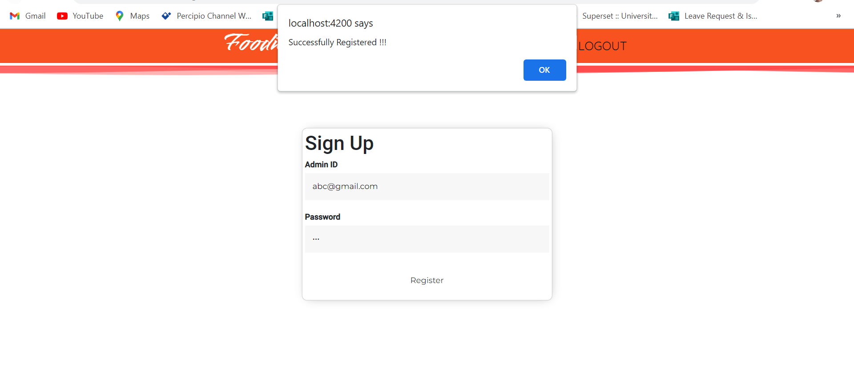
Admin Registration

Slide 45
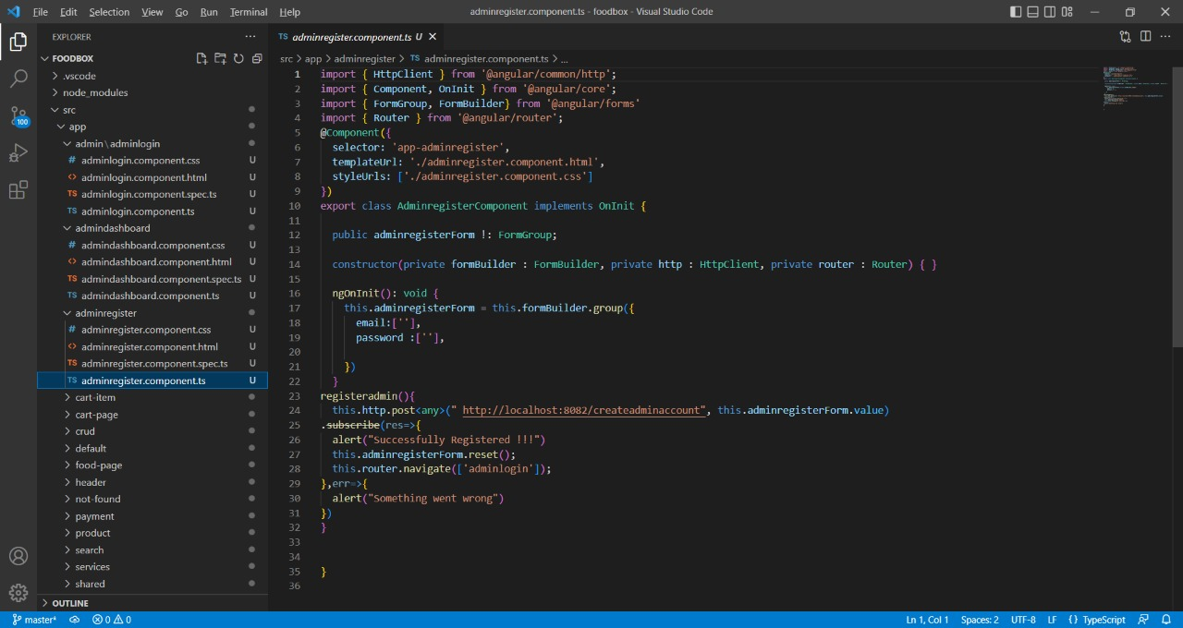
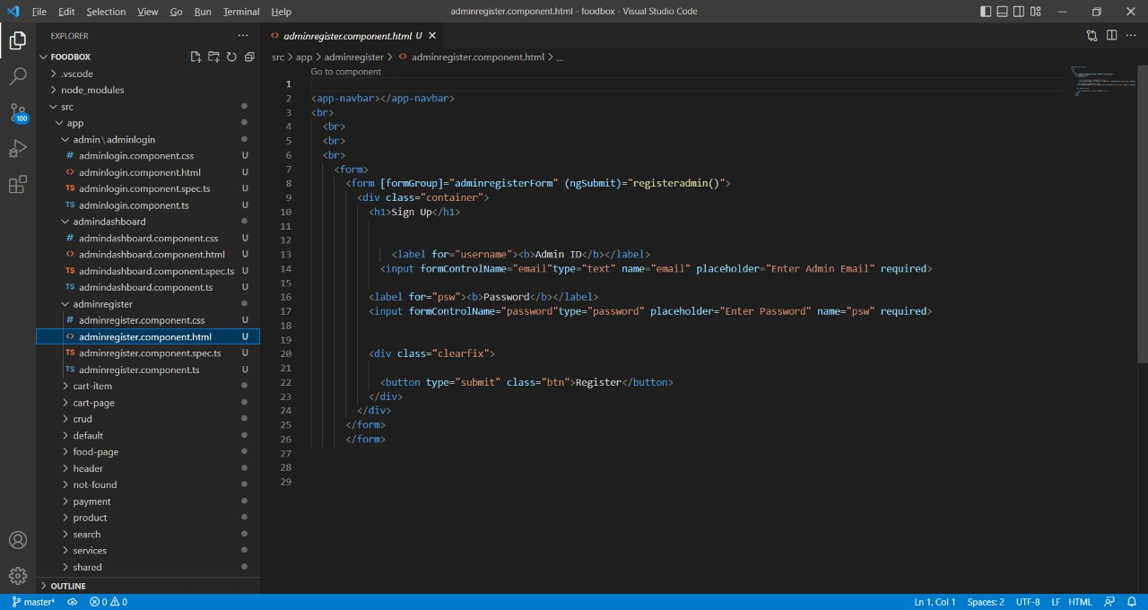

Slide 46
Advantages
Easy, fast, and comfortable:
In short, your customers choose to order food online because it is really at their fingertips.
More customers:
As the new life progresses with technologies, online orders and payments are expected to be accepted
Highly customizable:
Food ordering apps are highly customizable so you can easily advertise your logo, brand colors
Higher customer spend:
We all know that more and more customers are now engaging in digital products and services than ever before.

Slide 47

Disadvantages of Online Food Delivery System
Price:
One of the major drawbacks of online food ordering systems is price.
Limited menu:
Another disadvantage for food ordering systems is menu choices
Quality of food may be suffer:
One problem with the food ordering system is that the quality of food
The vibe of the restaurant is missing:

Slide 48
CONCLUSION
Made statement of the aims and objectives of the project.
The description of Purpose, Scope, and applicability.
We define the problem on which we are working in the project.
We describe the requirement Specifications of the system and the actions that
can be done on these things.
We included features and functions in detail, including screen layouts.
We designed user interface related to system.
Finally the system is implemented and tested according to test cases

Slide 49

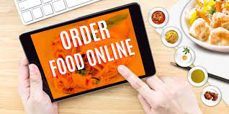
Future Scope For the Project
We can give more advance software for Online Food Ordering System including
more payment options like Gpay ,phonepe , etcc…
We can host the platform on online servers to make it accessible worldwide
It enables customers to browse the app and place orders for the food they select from the specific restaurants.
Later they can also see the estimated time for the delivery of the food that they have placed.
Restaurants after receiving orders update their customers with the confirmation text to let them know about the food being prepared

Slide 50
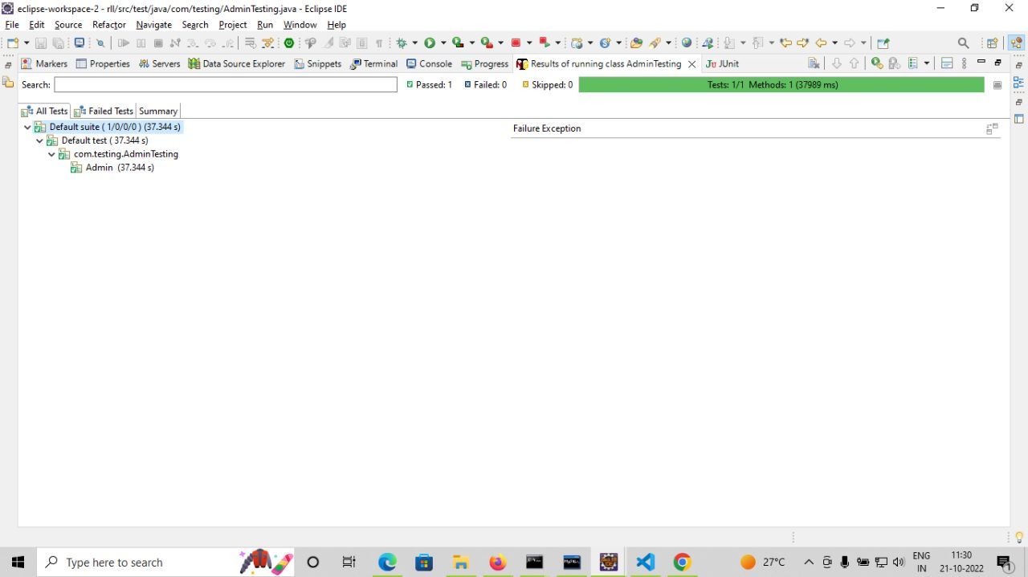
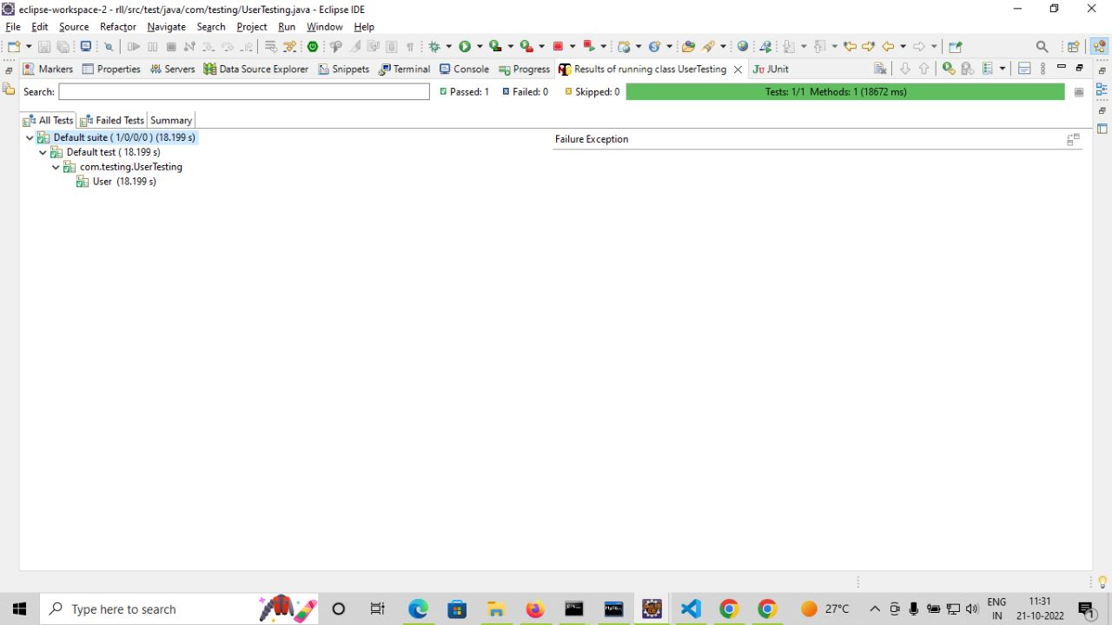
Testing automation

Slide 51
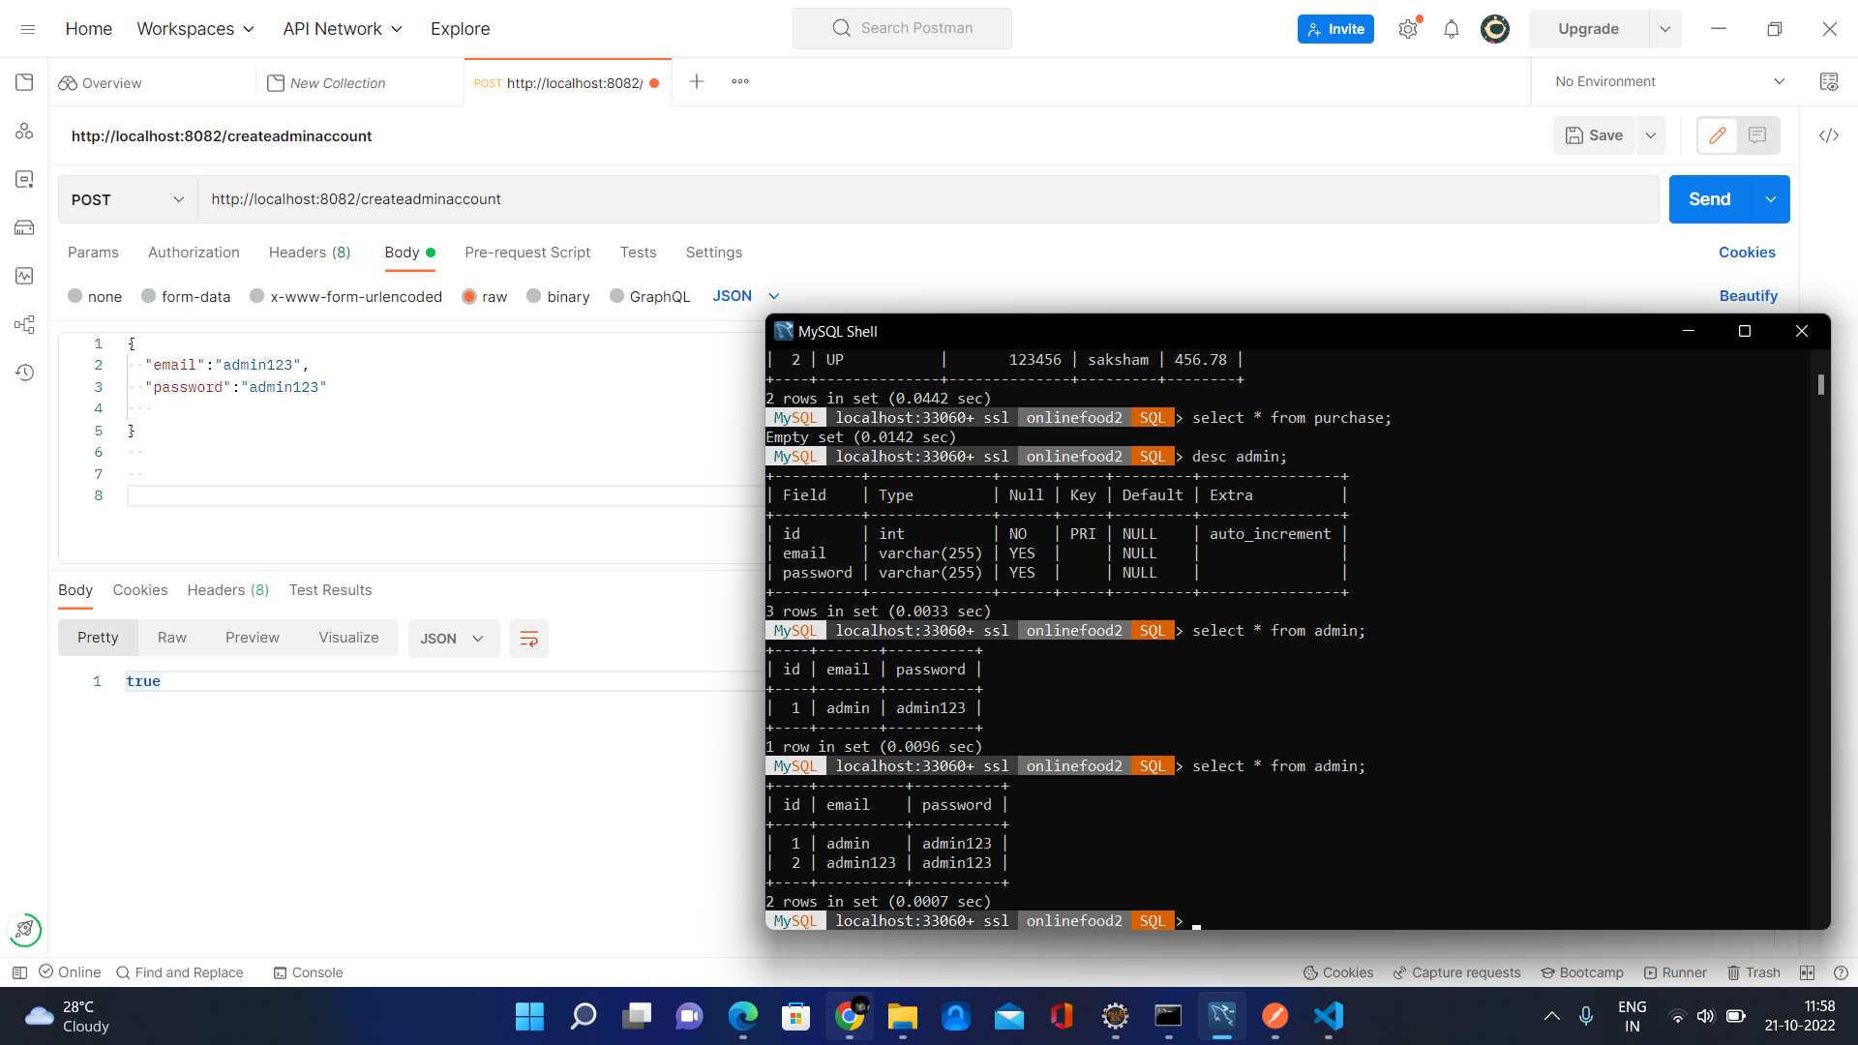
Postman testing

Slide 52
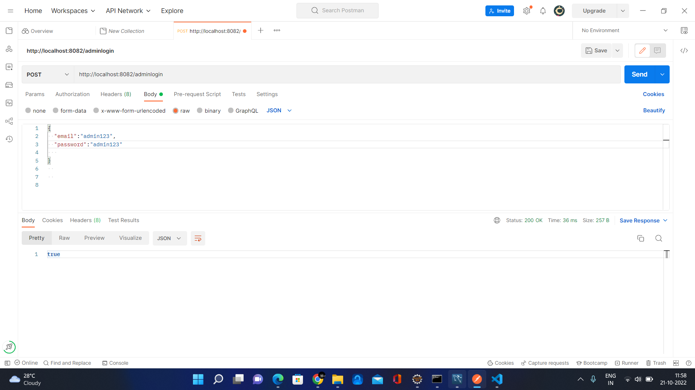

Slide 53
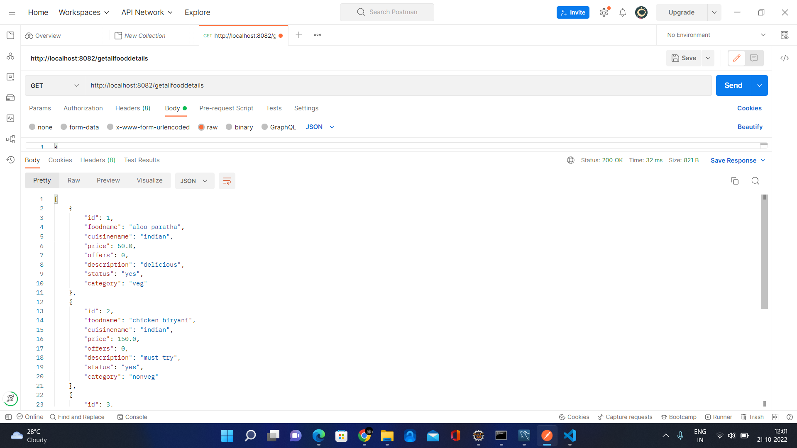

Slide 54
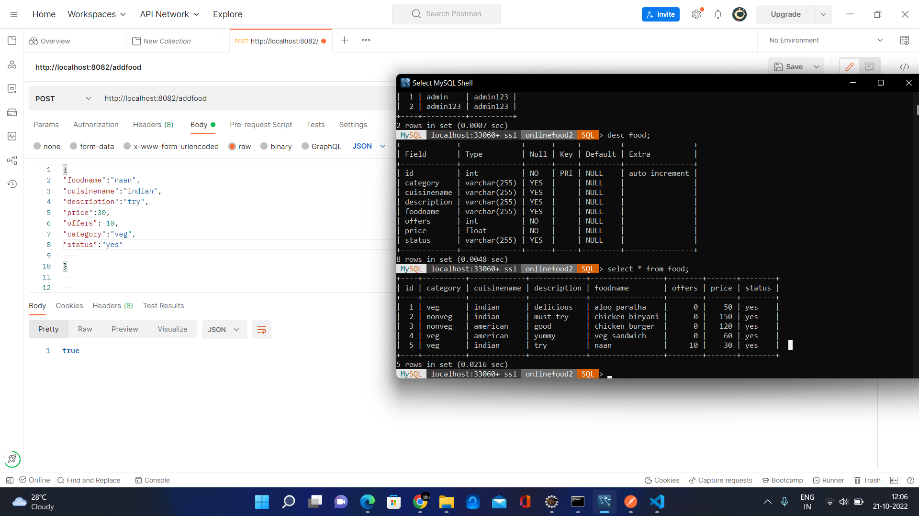

Slide 55


Slide 56
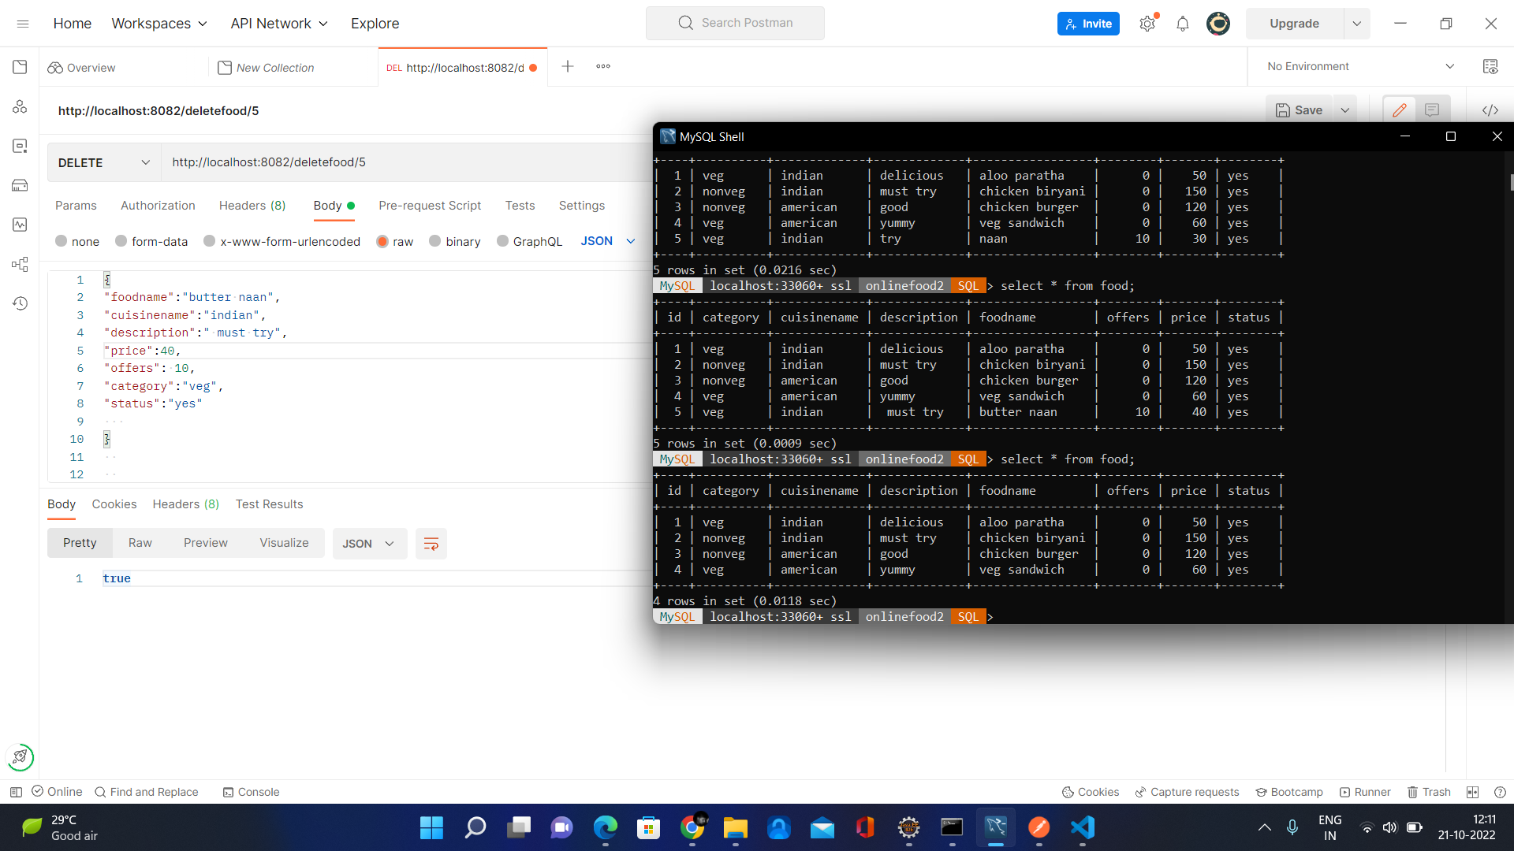

Slide 57
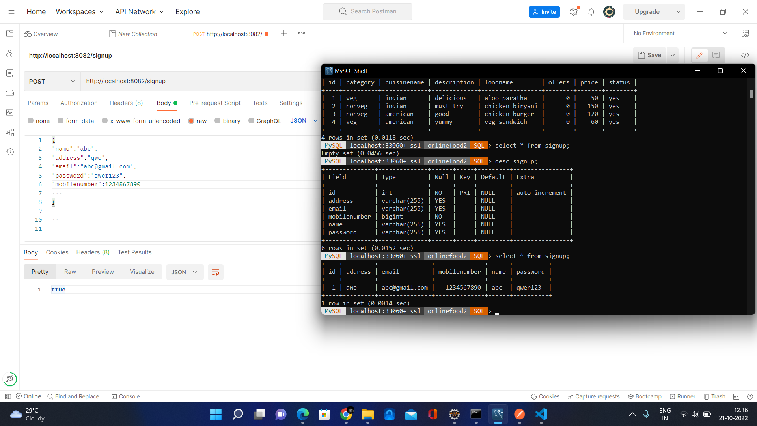

Slide 58
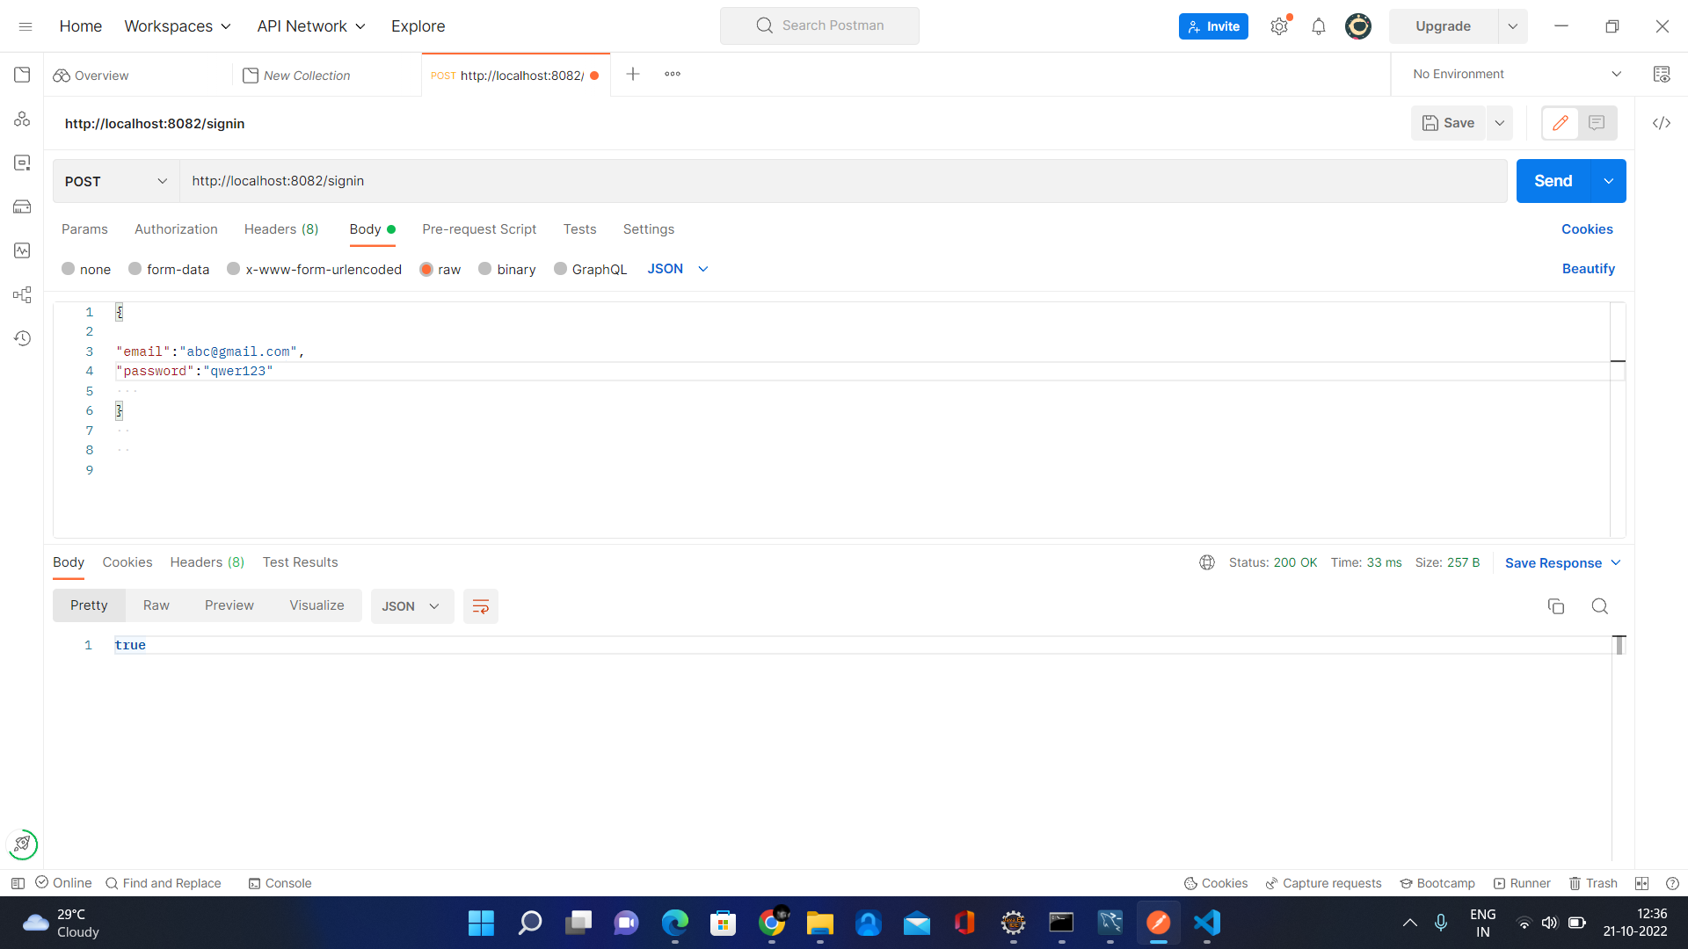

Slide 59


Slide 60
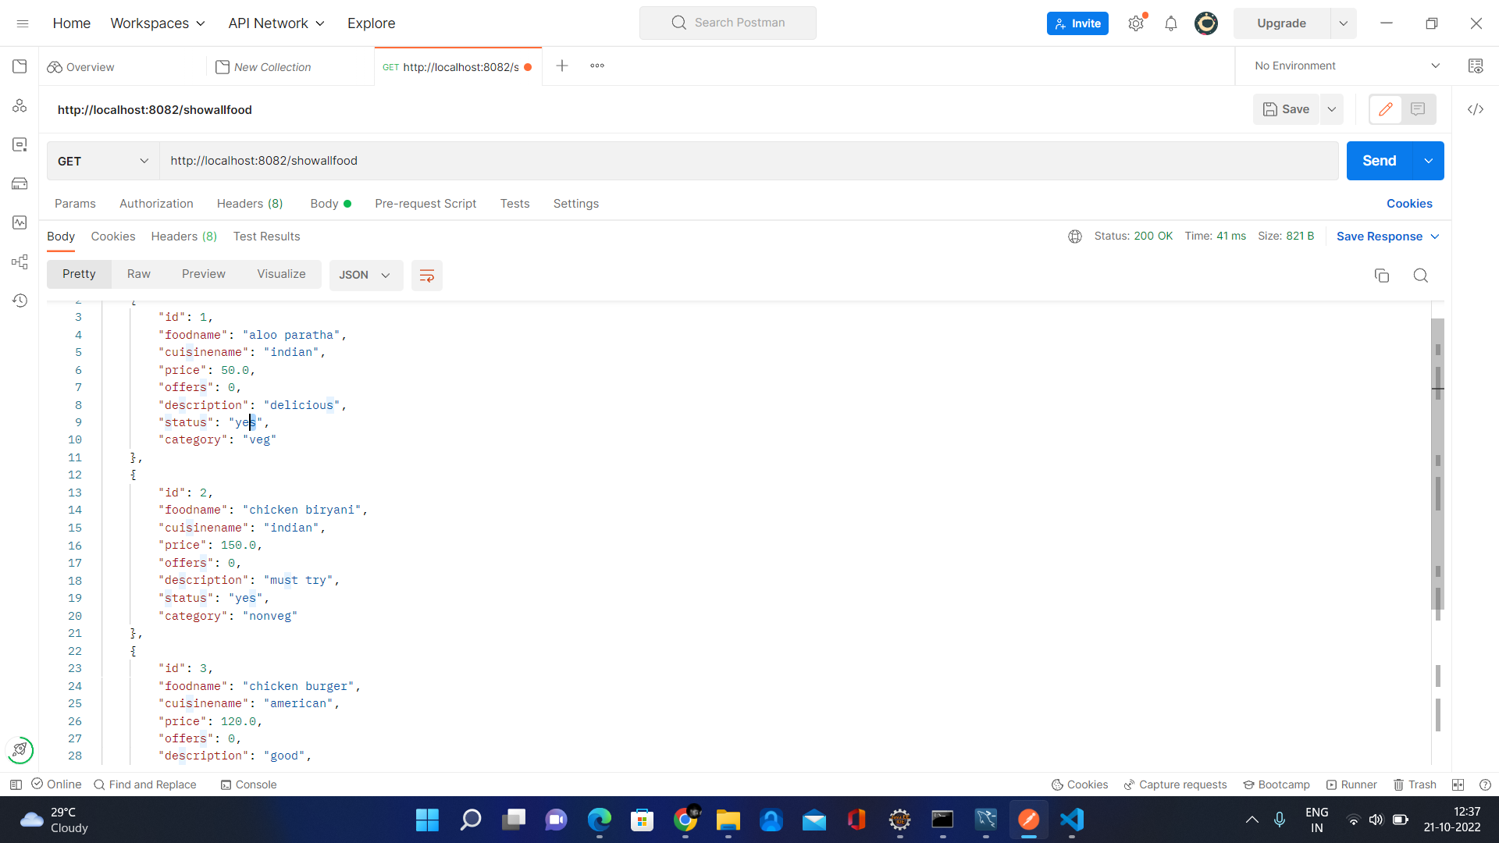

Slide 61
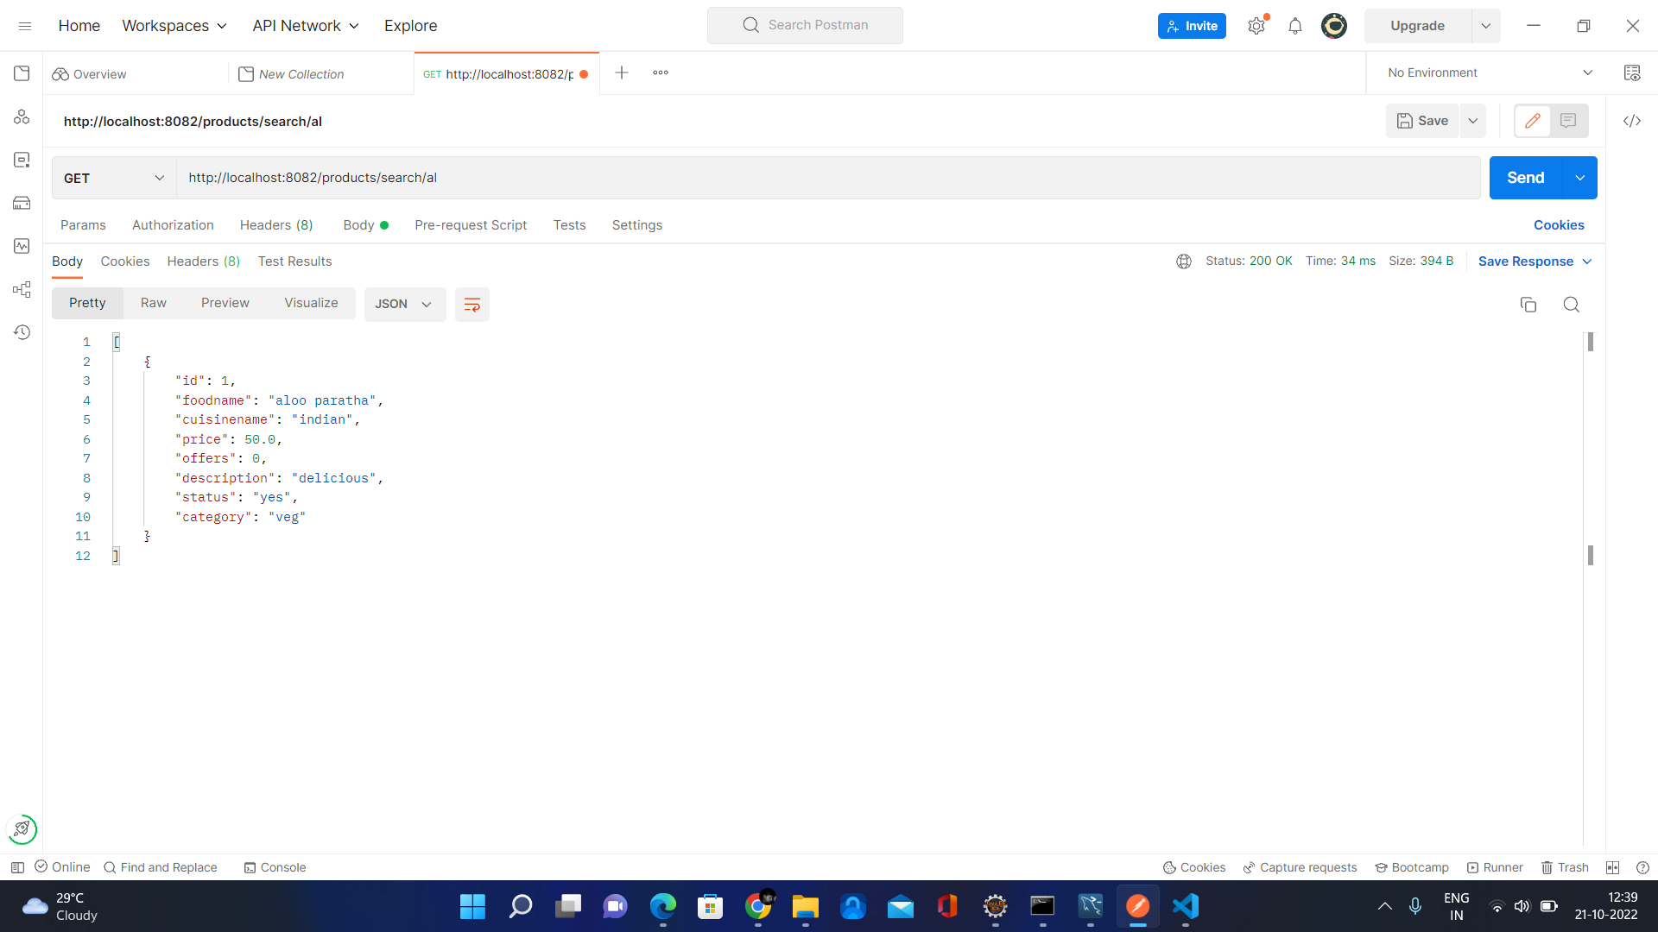

Slide 62
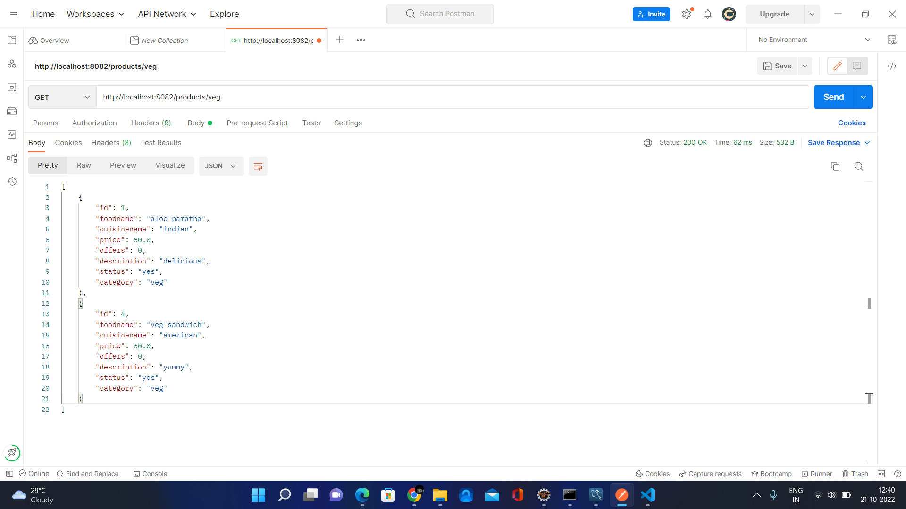

Slide 63
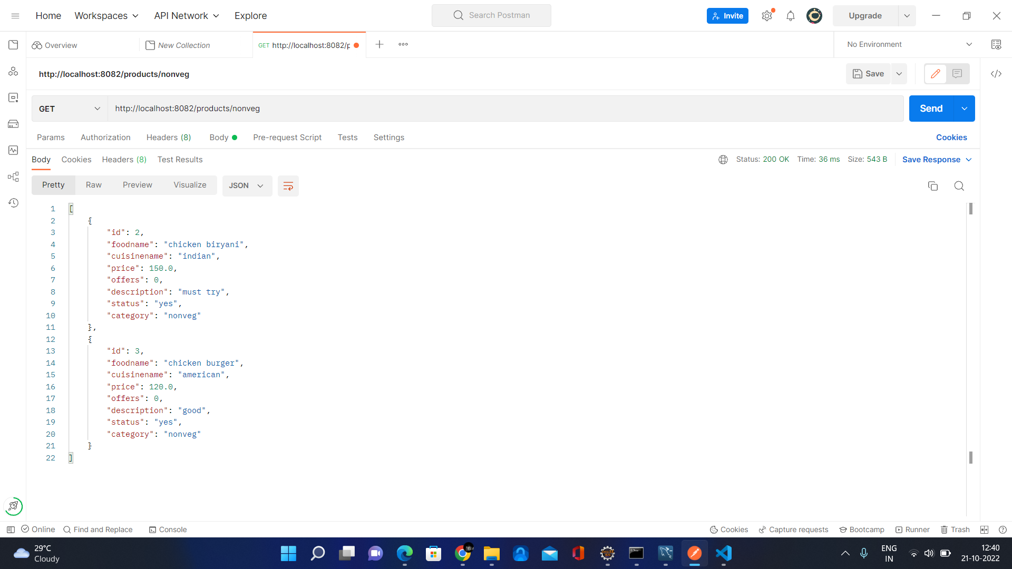

Slide 64
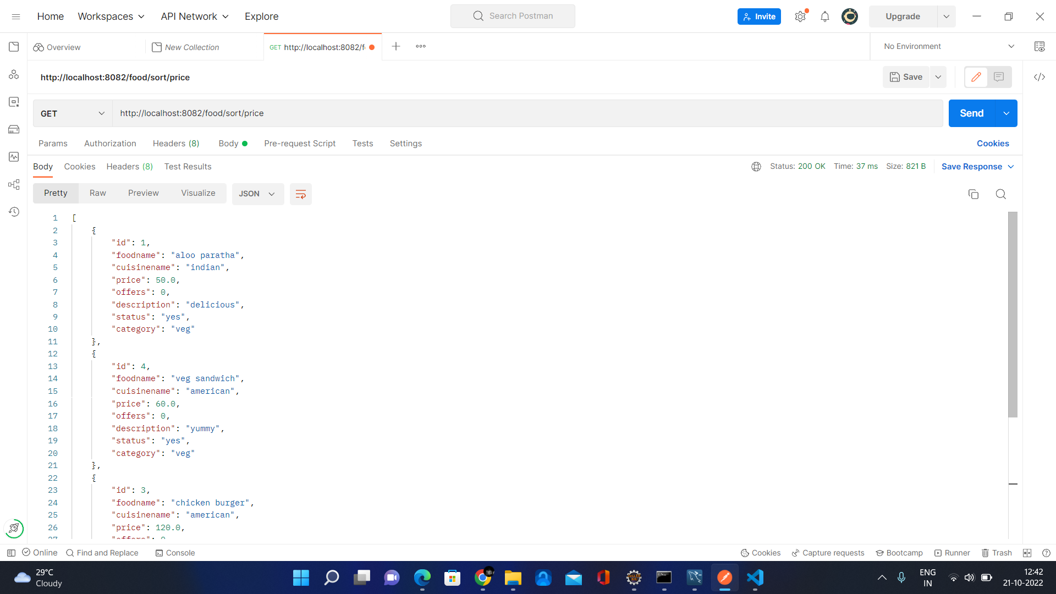

Slide 65
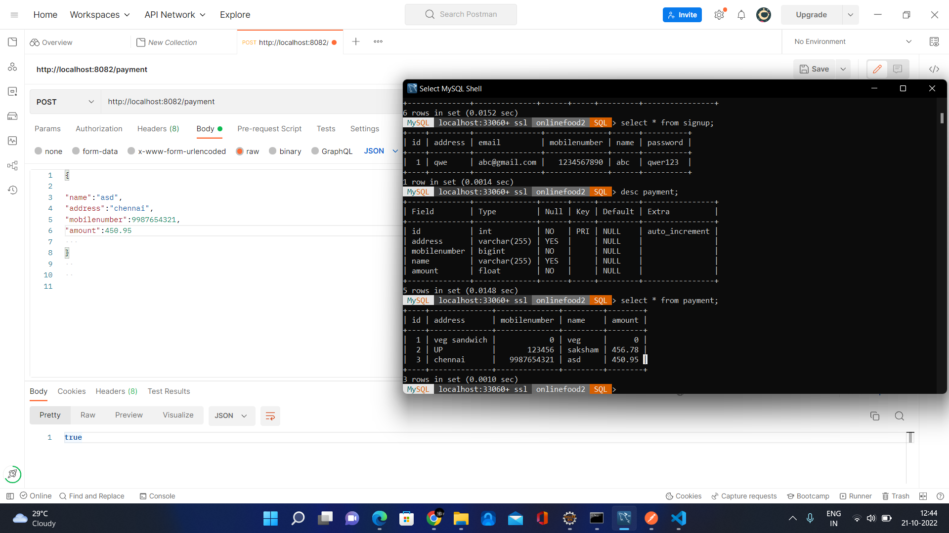

Slide 66

Thank U !!

